Slide 1
Dividing A Nation
Unit 5: U.S. History

Slide 2
Standard
SSUSH8 Explore the relationship between slavery, growing north-south divisions, and westward expansion that led to the outbreak of the Civil War.

Slide 3
Key Concepts
Missouri Compromise
James K. Polk
Manifest Destiny
Annexation of Texas
Founding of Oregon
Mexican American War
Treaty of Guadalupe Hidalgo
Wilmot Proviso
Compromise of 1850
Kansas-Nebraska Act
Popular Sovereignty
Dred Scott
Scott v. Sanford
John Brown
John Brown’s Raid on Harper’s Ferry
Election of 1860

Slide 4
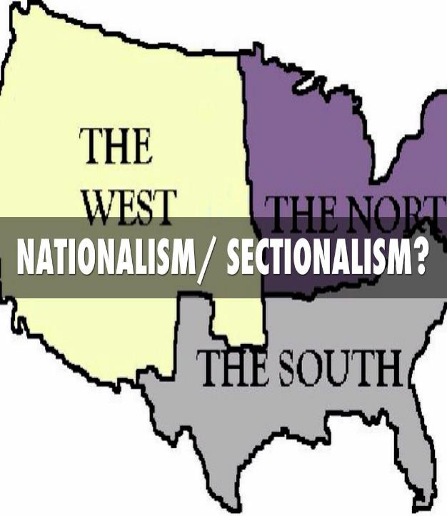

Slide 5
Why is the Politician Weighing Missouri and Maine?

Slide 6
The Missouri Compromise (SSUSH8a)
After the Louisiana Purchase, a debate raged in Congress over Missouri's application for statehood.
Slave states and free-states were equally represented in the Senate, and Missouri's admission would disrupt the balance of power.

Slide 8
Primary Source Analysis
… After the Missouri (Compromise of 1820)crisis it was no longer possible to pretend that the United States was a single nation with a single set of national interests. Although politicians in both North and South worked hard over the next two decades to suppress the issue of slavery in the national debate lest it drive a deeper wedge between the northern and southern wings of both national parties, the society of slaveholders would henceforth be in conflict with the society of free labor.…
Source: Robert Kagan, Dangerous Nation: America’s Foreign Policy from Its Earliest Days to the Dawn of the Twentieth Century, Alfred A. Knopf, 2006

Slide 9
The Missouri Compromise (SSUSH8a)
This issue was resolved when Congress passed the Missouri Compromise.
Maine would be admitted to the Union as a free state
Missouri would be admitted as a slave state
The balance between proslavery and antislavery senators was equal again––until the next state asked to enter the Union.

Slide 10
Primary Source Analysis
“It is my duty to assert and maintain by all constitutional means the right of the United States to that portion of our territory which lies beyond the Rocky Mountains. The world sees the peaceful triumphs of the hard work of our emigrants. To the US Government belongs the duty of protecting them adequately wherever they may be upon our soil. The protection of our laws and the benefits of our democratic government should be extended over them in the distant regions which they have selected for their homes.”
Source: James Polk – President of the U.S. 1845-1849

Slide 11
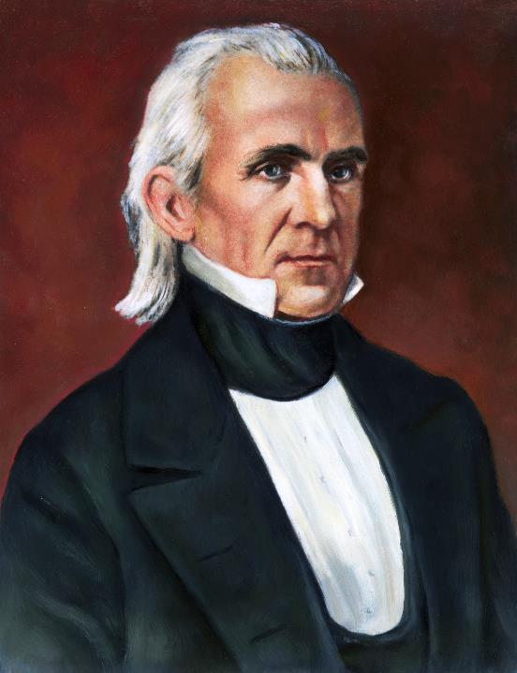
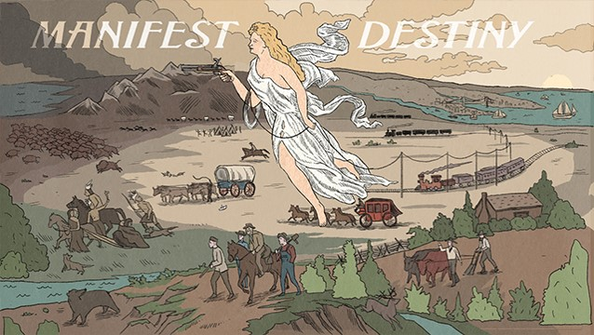

Slide 12
Role of James K. Polk (SSUSH8b)
James K. Polk was a strong supporter of Manifest Destiny
Manifest Destiny was the belief that God intended for the United States to control land between the Atlantic and Pacific Ocean
This would further the growth of nationalism and Henry Clay’s vision of the American System

Slide 13
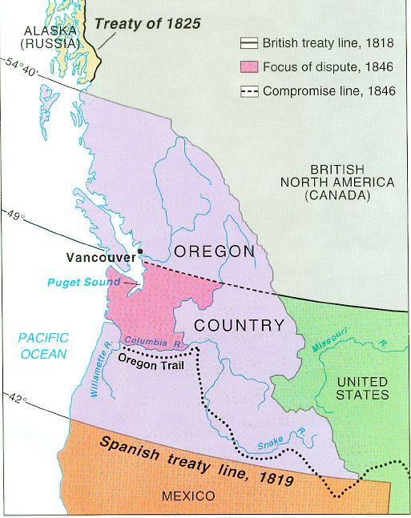
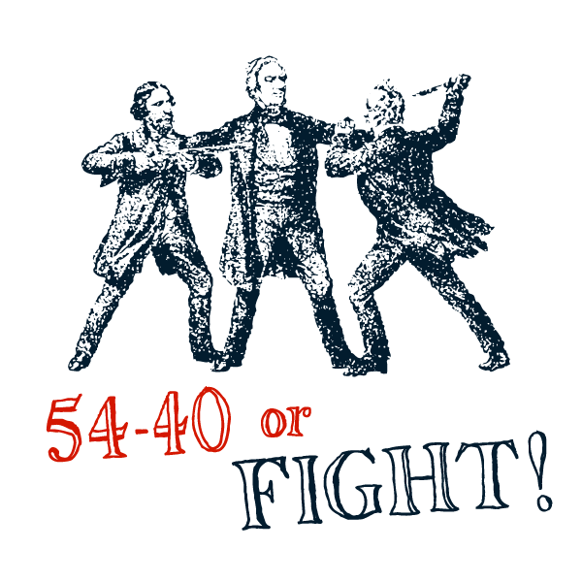

Slide 14
Role of James K. Polk (SSUSH8b)
Oregon (SSUSH8b)
Polk ultimately negotiated with Great Britain concerning Oregon in an attempt to avoid armed conflict over the region.
Instead of acquiring the entire Oregon territory to the 54° 40" line, a compromise was reached.
The Oregon territory would be divided and the northern section would remain in Great Britain's possession and the southern section would be annexed by the United States.

Slide 16
Role of James K. Polk (SSUSH8b)
Texas Annexation (SSUSH8b)
Increasing numbers of American settlers filled the region north of the Rio Grande, particularly in the 1820s and 1830s.
This resulted in a successful drive for Texas independence and a push for annexation that soon after the United States recognized the Texas Republic on March 3, 1837.

Slide 17
Review Questions
What was the impact of the Missouri Compromise?
How did the Missouri Compromise impact the following states?
What was the geographic impact of the Missouri Compromise?
Which president promoted Manifest Destiny by annexing Texas and Oregon?

Slide 18
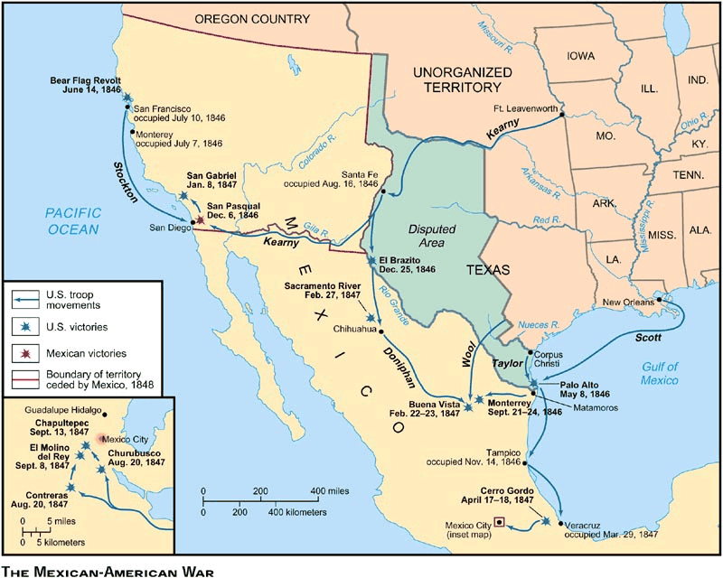
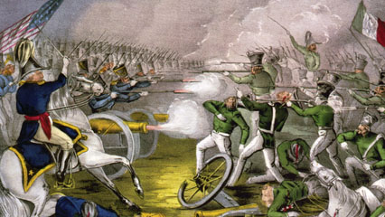
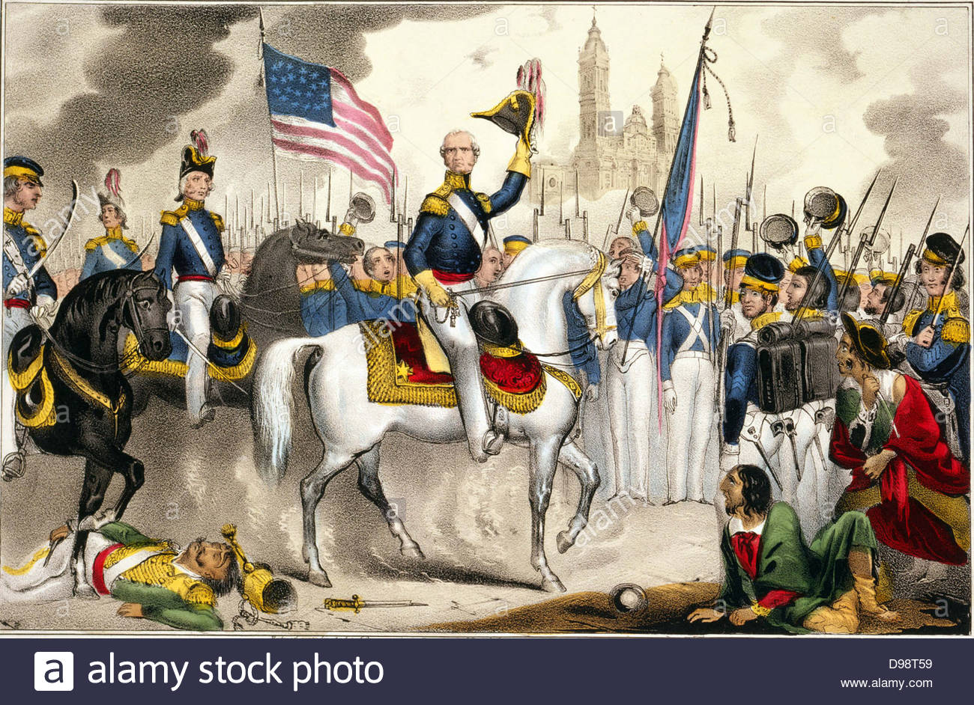

Slide 19
List 3 States Acquired from the Mexican American War

Slide 20
The Mexican American War (SSUSH8c)
Reason for Mexican-American War: the United States took Texas into the Union and set its sights on the Mexican territories of New Mexico and California.
The Treaty of Guadalupe Hidalgo officially ends the war and the U.S. gains California, New Mexico and Utah.

Slide 21
Primary Source Analysis
There shall be neither slavery, nor involuntary servitude in any territory on the continent of America which shall hereafter be acquired by or annexed to the United States…..except for crime, whereof the party shall have been duly convicted.
From a revised version of the Wilmot Proviso, 1842

Slide 22
The Wilmot Provision (SSUSH8c)
During the Mexican-American War, Congress debated whether slavery would be allowed in New Mexico and California if these territories were acquired from Mexico.
The antislavery position was outlined in a proposal called the Wilmot Proviso, but the House of Representatives failed to approve it, and the issue of whether to allow or prohibit slavery in new states remained unresolved.
The Mexican American War and the Wilmot Proviso led to an increase in sectionalism between the North and South.

Slide 23
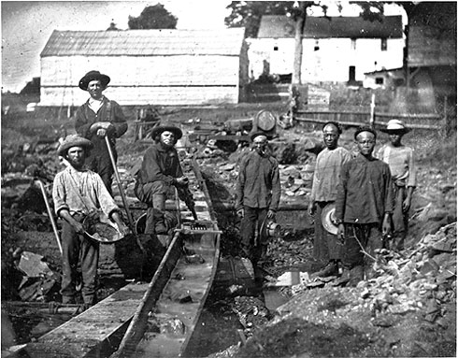
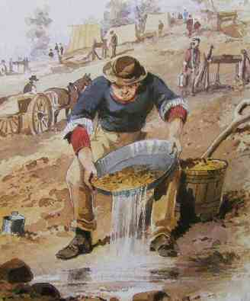

Slide 24
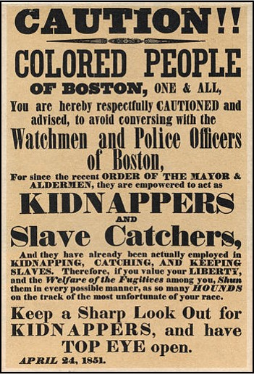

Slide 25
The Compromise of 1850 (SSUSH8d)
Due to land gained during the Mexican-American War and population growth in the West political tensions between free-states and slave states over the extension of slavery continued.
Eventually the free-states and slave states agreed to the Compromise of 1850.

Slide 26
The Compromise of 1850 (SSUSH8d)
The Compromise of 1850 stated:
California would be admitted to the Union as a free state.
Fugitive Slave Act: All citizens would be required to apprehend runaway slaves and return them to their owners. Those who failed to do so would be fined or imprisoned.
The slave trade abolished in the District of Columbia, but the practice of slavery would be allowed to continue there.
New Mexico and Utah would use popular sovereignty to determine whether they would be free states or slave states.

Slide 27
Review Questions
List the states were added as a result of the Mexican-American War?
What did the following regions want to do with the land gained from the Mexican American War?
Southern States:_____________________________________
Northern States:_____________________________________
Define: Sectionalism
List 3 provision included in the Compromise of 1850?
Why did politicians create the Compromise of 1850?

Slide 28
According to the Map Who or What will decide if Slavery is Permitted in Kansas or Nebraska?

Slide 29
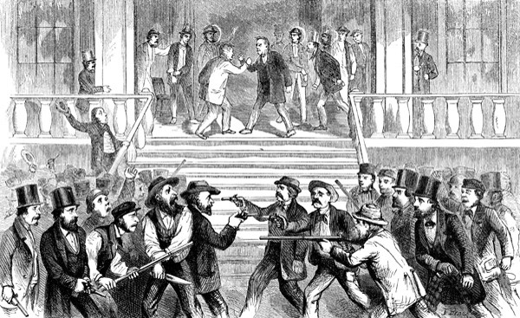

Slide 30
Kansas-Nebraska Act (SSUSH8e)
In 1854, Congress again took up the issue of slavery.
This time, Congress approved the Kansas- Nebraska Act, which repealed the Missouri Compromise of 1820
Kansas and Nebraska popular sovereignty (rule by the people) the right to decide for themselves whether their state would be a free or a slave state.

Slide 31
Kansas-Nebraska Act (SSUSH8e)
Pro and antislavery groups moved to Kansas to support their political views.
Popular sovereignty eventually failed and led to Bleeding Kansas a violent or warlike battle between pro and antislavery groups.

Slide 32
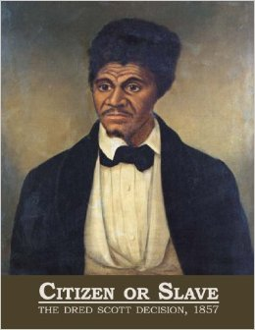

Slide 33
Dred Scott v. Sanford (SSUSH8e)
In 1857, the U.S. Supreme Court issued the Scott v. Sanford decision, settling a lawsuit in which an African American slave named Dred Scott claimed he should be a free man because he had lived with his master in slave states and in free-states.

Slide 34
Dred Scott v. Sanford (SSUSH8e)
The Court ruled:
No African American could ever be a U.S. citizen
Congress could not prohibit slavery in federal territories
Popular sovereignty was unconstitutional
The Dred Scott decision gave slavery protection under the Constitution.

Slide 35
Review Questions
What was the political significance of the Kansas-Nebraska Act?
Define: Popular Sovereignty
Who was Dred Scott?
What was the significance of Scott v Sanford?

Slide 36
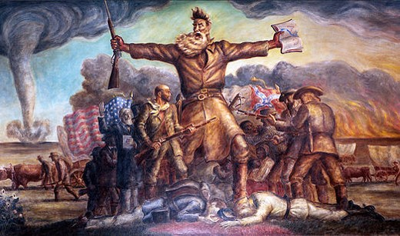
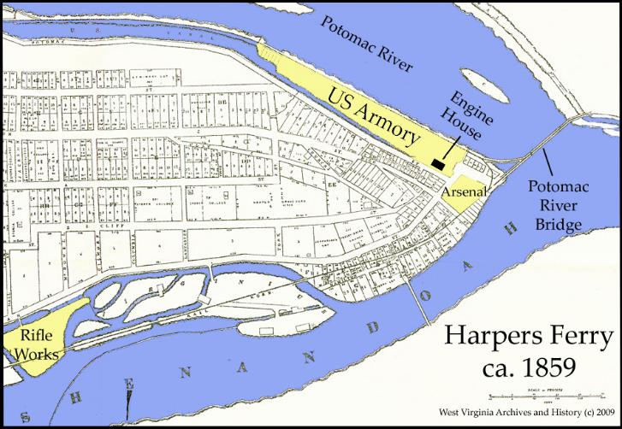

Slide 37
John Brown’s Raid on Harper’s Ferry (SSUSH8e)
John Brown, a white abolitionist, decided to fight slavery with violence and killing.
He led a group of white and black men in a raid on the federal armory at Harpers Ferry, Virginia.
John Brown’s Raid was to deliver the weapons and ammunition to slaves, who would then use them in an uprising against slaveholders and proslavery government officials.

Slide 39
John Brown’s Raid on Harper’s Ferry (SSUSH8e)
Brown raid failed and he was convicted of treason against the state of Virginia and executed by hanging.
Southerners thought Brown was a terrorist. Northerners thought he was an abolitionist martyr.

Slide 40
How does this map illustrate the political division in the country in 1860?

Slide 41
Primary Source Analysis
The Election was not the Cause [of secession] it was but the last feather which you know breaks the Camel’s back. Sectional hostility manifested in hostile legislation by states and raids of organized bodies sustained by Contributions . . . of northern Society furnish to us sufficient cause. . . .
Source: letter that Jefferson Davis wrote to George Lunt on January 17, 1861

Slide 42
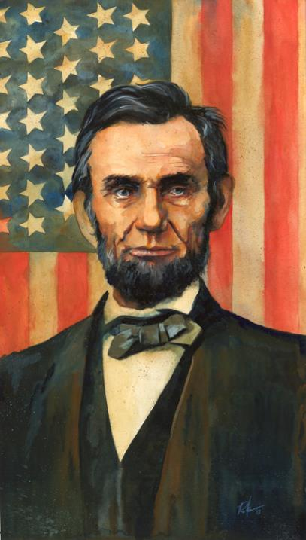

Slide 43
The Election of 1860 (SSUSH8e)
By the time of the presidential election of 1860, the country was at a boiling point regarding slavery.
The southern states feared that Lincoln would seek not only to prevent slavery in the new territories, but to dismantle it in the South as well.
When Lincoln won the election, South Carolina responded by seceding (withdrawing) from the Union on December 20, 1860.
Within two months, six other states had seceded as well: Mississippi, Alabama, Georgia, Florida, Louisiana and Texas.

Slide 44
Review Questions
Who was John Brown?
How did the following regions feel about John Brown’s Raid on Harpers Ferry?
South:____________________________________
North: ________________________________________
What president was elected in 1860?
How did the Presidential Election of 1860 impact the United States?
List the four events that led to the Civil War

