Slide 1
Creating A Nation
U.S. History- Unit 4

Slide 2
Standards
SSUSH6 Analyze the challenges faced by the first five presidents and how they were resolved.
SSUSH7 Investigate political, economic, and social developments during the Age of Jackson.

Slide 3
Key Concepts
Whiskey Rebellion
Farwell Address
Seditions Acts
Election of 1800
Louisiana Purchase
Lewis and Clark
War of 1812
Impressment
Nationalism
Monroe Doctrine
Jacksonian Democracy
Suffrage
The Nullification Crisis
Nullify
Sectionalism
States’ Rights
The American System
The Second Great Awakening
Temperance Movement
Women’s Movement
Seneca Falls Conference
The Abolitionist Movement
Slave Rebellions
Nat Turner’s Rebellion

Slide 5
Primary Source Analysis
I walk on untrodden ground. There is scarcely any part of my conduct which may not hereafter be drawn into precedent.
By George Washington

Slide 6
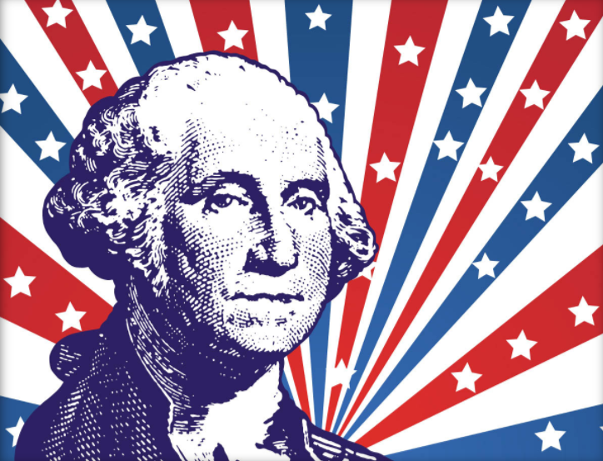
Precedents (SSUSH6a)
During George Washington time as the President of the United States, he set many precedents that would shape the role of the President of the United States.
Here are examples of a couple of his precedents:
Set the rule for two term limits for president
Initiated the Farewell Address for presidents
Created the cabinet for the executive branch
Use military force as commander in chief (WHISKEY REBELLION)

Slide 7
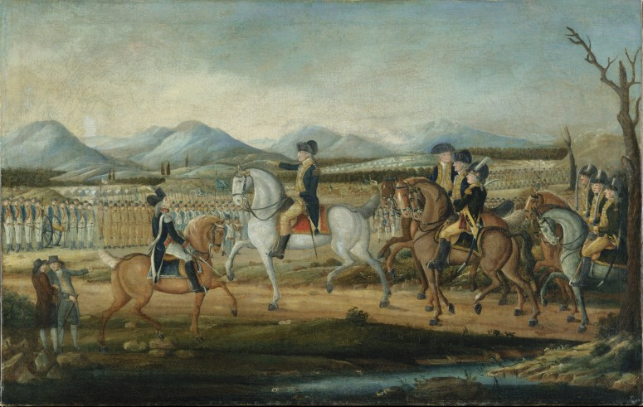
Whiskey Rebellion (SSUSH6a)
In 1791, an excise tax on whiskey was imposed upon the U.S.
This tax was very unpopular among farmers in the western regions of PA, MD, VA, and NC.
Many of these farmers made their living converting grain into whiskey.
Their protest eventually resulted in the Whiskey Rebellion when Pennsylvania farmers refused to pay the tax and resorted to violence.
The uprising ended when President Washington organized a military force that marched into PA and halted the resistance.
This proves the strength of the new government under the Constitution

Slide 8
Farewell Address (SSUSH6a)
Washington was the most influential and popular figure in the United States.
During Washington’s Farewell Address, he warned citizens about two future political issues:
1) He favored nonintervention (Isolationism or Neutrality) in European affairs. He avoided siding with France against Great Britain on political issues.
2) He warned about the dangers of political parties (factions). Example: Federalist vs. anti-Federalist.

Slide 9
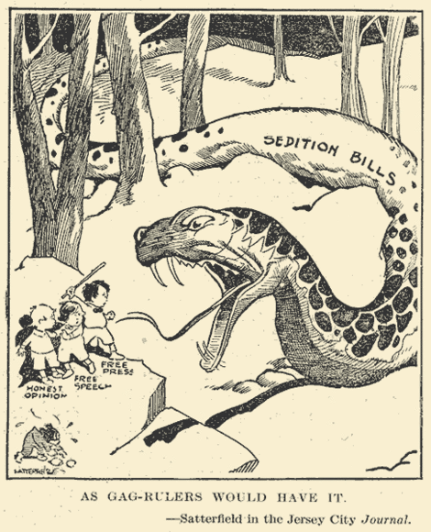

Slide 10
Sedition Act (SSUSH6b)
Like Washington, John Adams set examples that influenced future presidents as well as the course of American history and continued the disagreement between Federalist (Adams) and anti-Federalist (Jefferson)
During Adams Presidency, Congress and Adams passed the Alien and Sedition Acts.
The Alien Act: increased citizenship requirements so that Jefferson could not receive support from the immigrant community.
The Sedition Act: tried to stop the anti-Federalist criticism with attempts to limit the speech and press rights of Jefferson’s followers.

Slide 11
Sedition Act (SSUSH6b)
Federalists often used the Alien and Sedition Acts to silence critics (usually Democratic-Republicans).
These acts tended to help the Federalists because immigrants who had been in the country for only a short time were usually poorer and often drawn to the Republicans who represented the "common man."

Slide 12
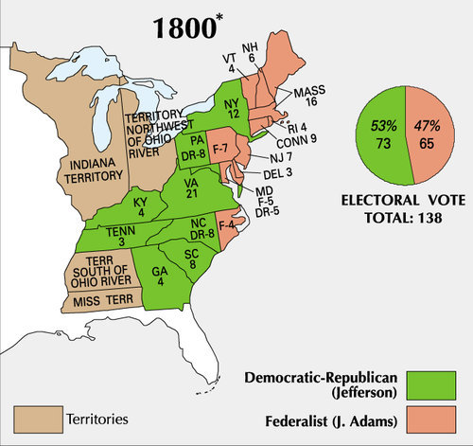

Slide 13
Election of 1800 (SSUSH6b)
In the United States Presidential election of 1800, sometimes referred to as the "Revolution of 1800," Vice President Thomas Jefferson defeated incumbent president John Adams.
Central issues included the Sedition acts, by which Federalists were trying to stifle dissent, especially by Republican newspaper editors.
The Sedition Act and the Election helped usher in Thomas Jefferson and a generation of Democratic-Republican Party rule.

Slide 14
Primary Source Analysis
Article IV Section 3.
New states may be admitted by the Congress into this union; but no new states shall be formed or erected within the jurisdiction of any other state; nor any state be formed by the junction of two or more states, or parts of states, without the consent of the legislatures of the states concerned as well as of the Congress. The Congress shall have power to dispose of and make all needful rules and regulations respecting the territory or other property belonging to the United States; and nothing in this Constitution shall be so construed as to prejudice any claims of the United States, or of any particular state.
Source: The Constitution

Slide 15
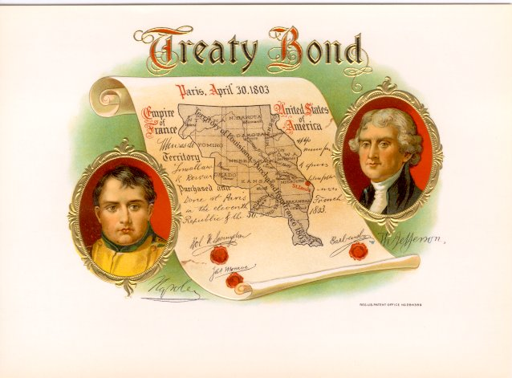

Slide 16
Louisiana Purchase (SSUSH6c)
In the early 1800s, President Thomas Jefferson sent James Monroe to France to negotiate the purchase of the important port city of New Orleans.
Although, Jefferson was unsure if the Constitution gave him the authority to purchase the Louisiana Territory.
The Louisiana Purchase of 1803 was the United States' largest land purchase, roughly doubling the country's size.

Slide 17
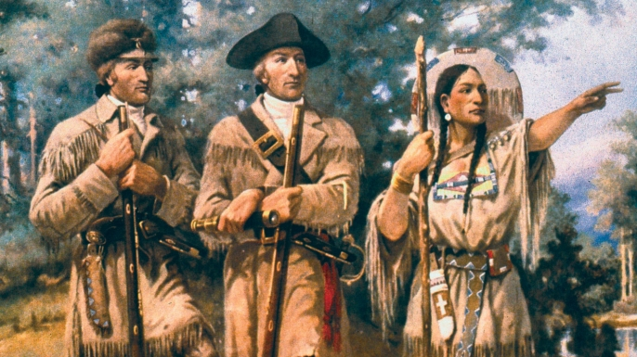
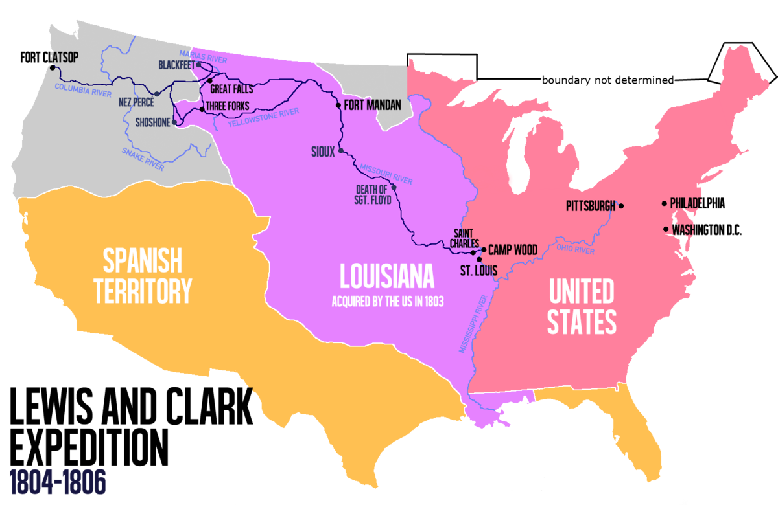
Louisiana Purchase (SSUSH6c)
France and Napoleon controlled New Orleans and much of the land west of the Mississippi River.
In 1803, Napoleon agreed to sell to the United States not only New Orleans but also the entire Louisiana Territory for $15 million.
Thomas Jefferson sent the Lewis and Clark Expedition to explore the Louisiana Purchase and the western lands all the way to the Pacific Ocean.

Slide 18
Review Questions
List a precedent that was established under Washington’s Presidency
Why was the Sedition Act created during the John Adam’s Presidency?
How did Adam’s Sedition Act influence the election of 1800?
Why did Thomas Jefferson think twice about the Louisiana Purchase?
How did the Louisiana Purchase benefit America?

Slide 20
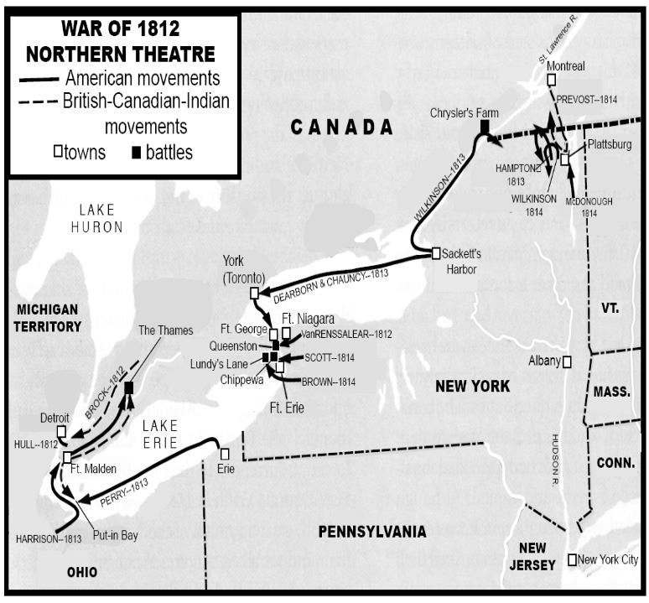

Slide 21
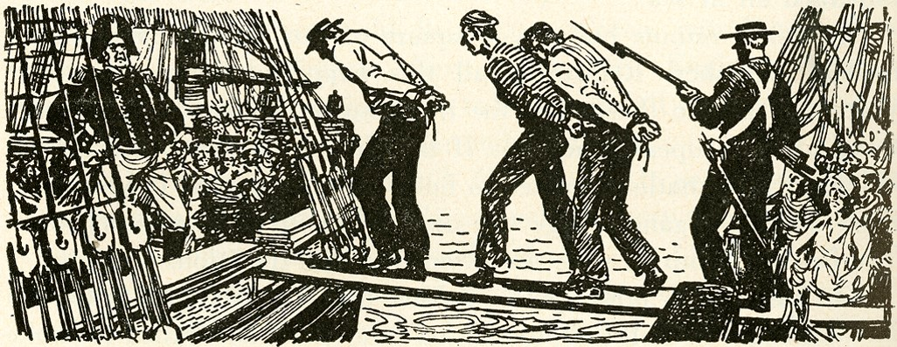

Slide 22
War of 1812 (SSUSH6d)
In 1812, James Madison and America declared war on Great Britain.
The three causes of the War of 1812
Americans objected to Britain trying to blockade
The British policy of impressment.
British impressment forced thousands of American sailors to serve in the British navy after their American ships were captured at sea.
3) Americans wished to drive the British out of North America altogether by conquering Canada

Slide 23
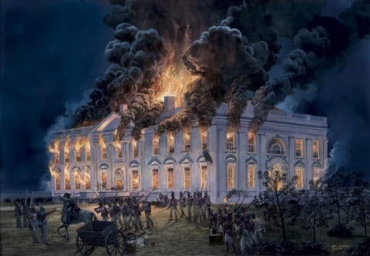
National Identity (SSUSH6d)
Perhaps most importantly, the War of 1812 helped produce a stronger sense of nationalism (pride in ones country) among US citizens.
People felt a great deal of pride after standing up to the mighty British again.

Slide 24
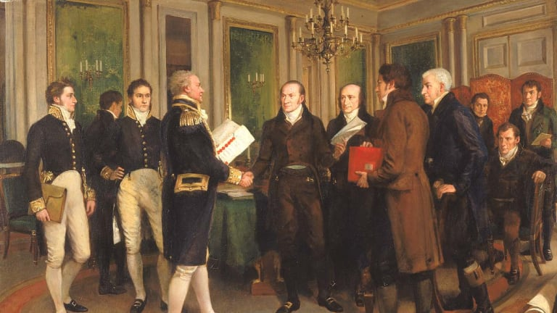
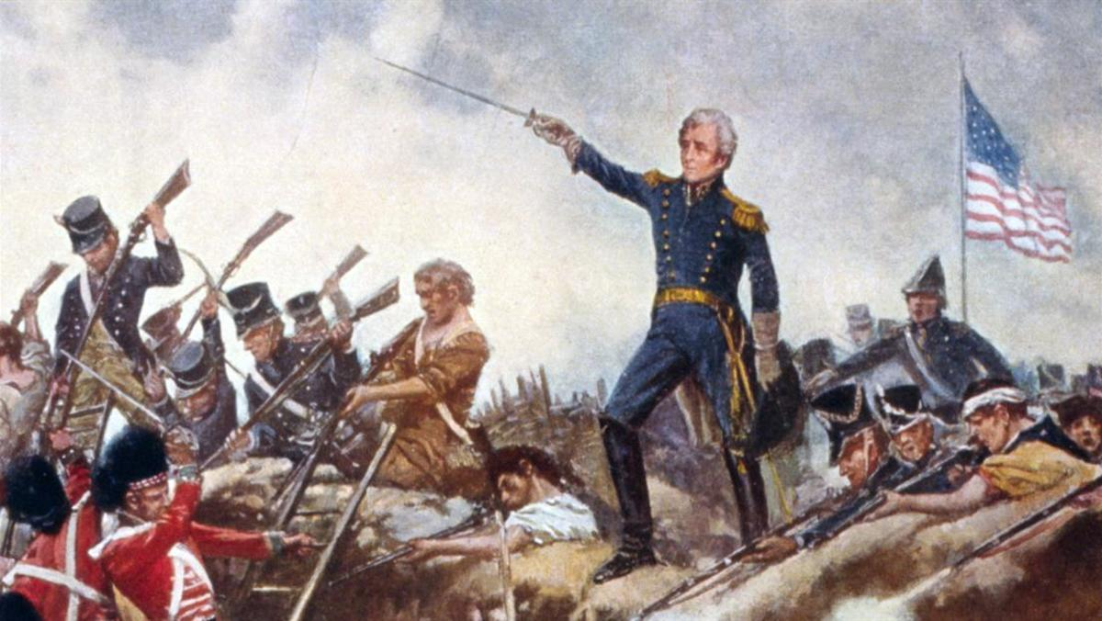
Treaty of Ghent (SSUSH6d)
The most decisive victory in the war actually came AFTER the Treaty of Ghent was signed.
The Treaty of Ghent was signed on December 24th, 1814 and the Battle of New Orleans began on January 8th, 1815.
The Treaty declared an armistice (truce, agreement to stop fighting)
General Andrew Jackson led the American forces. The battle was an overwhelming victory for the U.S. and made Jackson a national hero.
The British suffered the loss of over 2,400 compared to the U.S. who loss 300

Slide 25
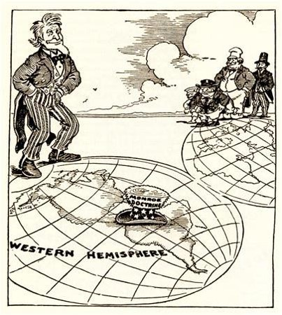

Slide 26
Monroe Doctrine (SSUSH6e)
The Monroe Doctrine defined U.S. foreign policy in the Americas (North and South America).
Reasons for the Monroe Doctrine
1) U.S. concerned about the fall of the Spanish Empire in Mexico
2) British desire to spread into the Western Hemisphere
The Monroe Doctrine announced that the United States would prevent European nations from interfering with independent American countries.
Further, if European wars broke out in the Americas, the United States would view the wars as hostile actions against the United States.
http://study.com/academy/lesson/monroe-doctrine-definition-purpose-summary.html

Slide 27
Review Questions
Why did James Madison declare war on Britain in the War of 1812?
Define: Impressment
How did the War of 1812 impact America?
What was the significance of James Monroe’s presidency?
What was the significance of the Monroe Doctrine?

Slide 28
Henry Clay and the American System (SSUSH7b)
After the War of 1812, Americans felt good about themselves.
But, Britain still supplied America with most of its good, this hurt American manufacturing
Henry Clay, a member of the United States House of Representatives, had a plan to aid American businesses.

Slide 29
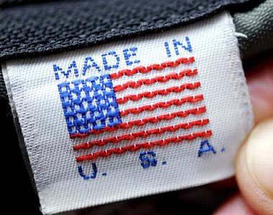

Slide 30
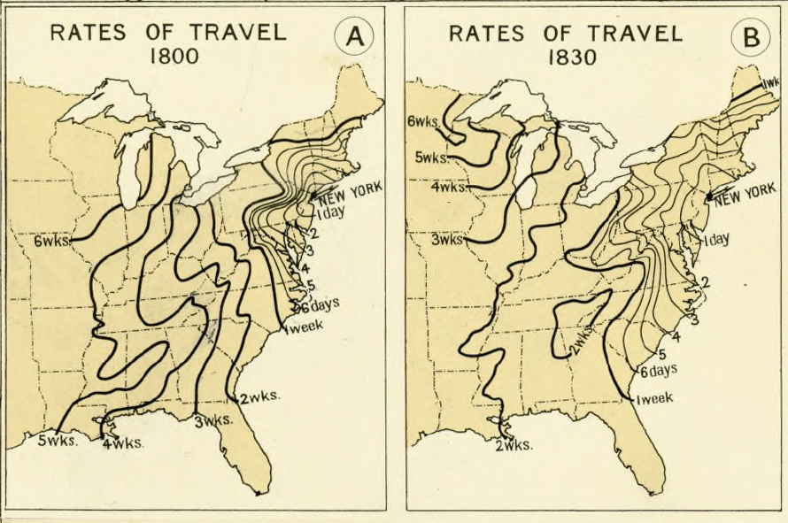
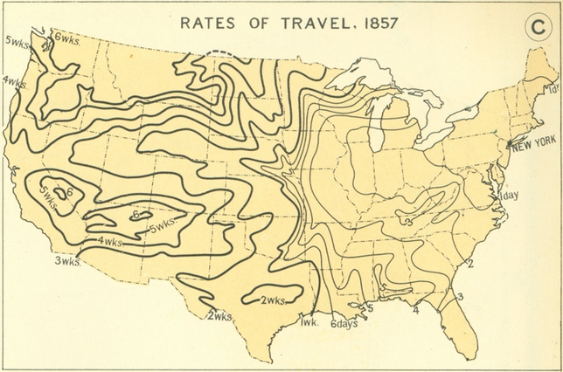

Slide 31
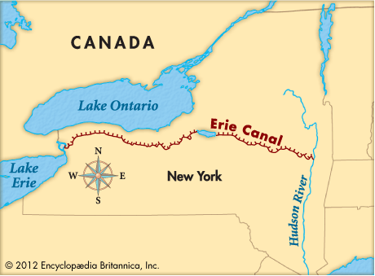
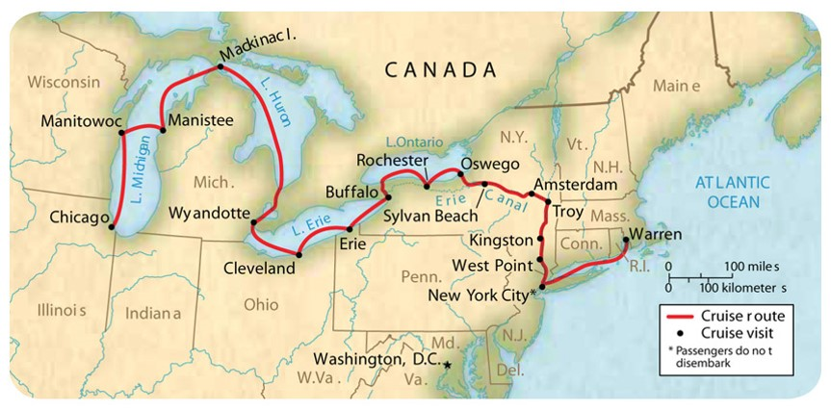
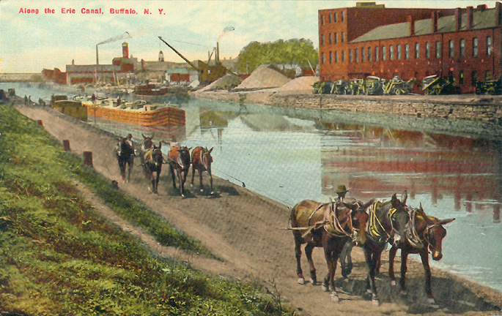

Slide 32
Henry Clay and the American System (SSUSH7b)
He called it the American System. It included the following:
A tariff – A tariff is a tax on imported goods. It made European goods more expensive and encouraged Americans to buy cheaper products made in America. The tariff also made the country money, which would be used to improve things.
A National Bank - The establishment of a national bank that would promote a single currency (money), making trade easier.
Highways and Canals –These roads and canals would make trade easier between merchants and farmers in the North, South, and West.

Slide 33
Henry Clay and the American System (SSUSH7b)
Henry Clay hoped the American System would help the United States be able to become independent from Europe and increase Nationalism.
http://study.com/academy/lesson/henry-clay-and-the-american-system-lesson-quiz.html

Slide 34
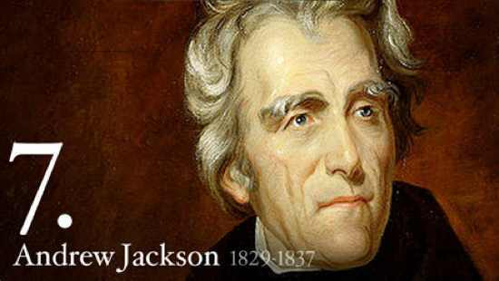

Slide 35
Why did Voter Turnout increase during Andrew Jacksons Presidency (Jacksonian Democracy)?

Slide 37
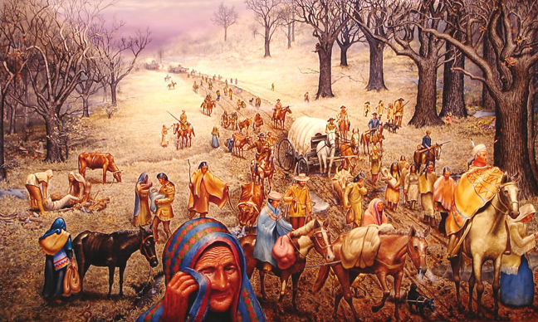

Slide 39
Jacksonian Democracy (SSUSH7a)
President Andrew Jackson's brand of politics and the changes he inspired came to be called Jacksonian Democracy.
Jackson believed strongly in western expansion and the rights of white, frontier settlers.
What was Jacksonian Democracy?
Expansion of Suffrage: Increased voter participation by allowing all adult white males, not just landowners, to vote.
Indian Removal Act: Under this policy, the US government forced Native Americans off lands it wanted for white settlement. (Trail of Tears)
Nullification Crisis: Wanted a stronger executive branch and a weaker Congress and state governments

Slide 40
Primary Source Analysis
… a convention, assembled in the State of South Carolina, have passed an ordinance, by which they declare that several acts and parts of acts of the Congress of the United States… are unauthorized by the Constitution of the United States… The ordinance is founded… on the strange position that any State may not only declare an act of Congress void, but prohibit its execution…
Source: Andrew Jackson

Slide 41
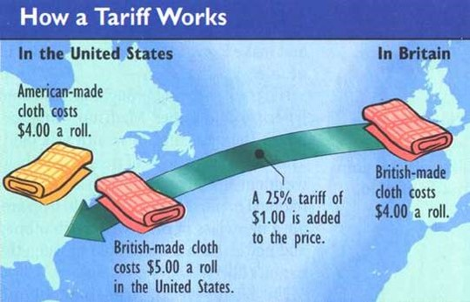

Slide 42
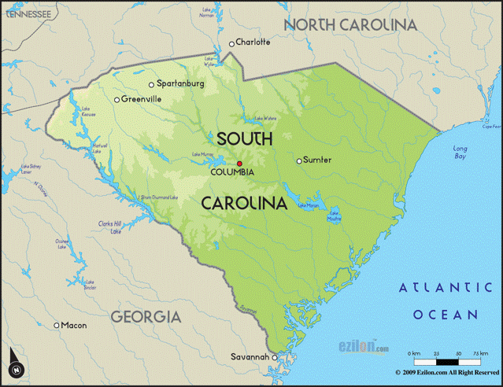

Slide 43
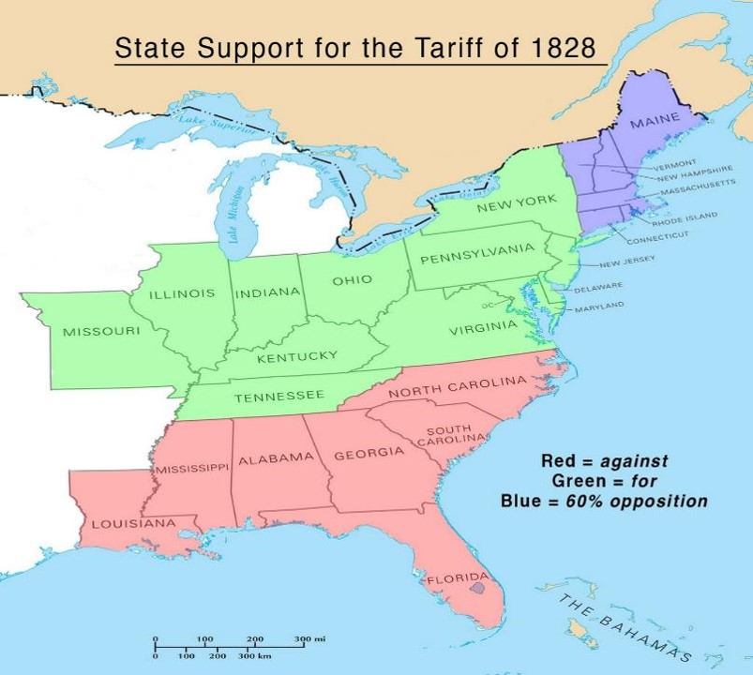

Slide 44
The Nullification Crisis (SSUSH7a)
The Nullification Crisis, resulted when Vice President John C. Calhoun and South Carolina sought to nullify (cancel) a high tariff (tax) Congress had passed on manufactured goods imported from Europe.
The tariff and federal law helped northern manufacturers but hurt southern plantation owners, so legislators nullified the tariff in South Carolina.

Slide 45
The Nullification Crisis (SSUSH7a)
Calhoun’s had two arguments for the Nullification Crisis
Sectionalism: loyalty to a region (North vs. South) and not the entire United States.
States’ rights: the idea that states have certain rights and political powers separate from those held by the federal government
Northerners believed sectionalism and states’ rights would destroy the Union and lead to a Civil War.

Slide 46
Review Questions
List 3 significant results of Andrew Jackson’s Presidency (JACKSONIAN DEMOCRACY)?
How did Jacksonian Democracy impact white males over 21 years old?
What Presidents was involved in the Nullification Crisis?
What South Carolina Senator was involved in the Nullification Crisis?
Define Nullify
Why did South Carolina want to nullify the tariffs of 1828 and 1832?
What was the result of the Nullification Crisis?
What was the significance of the Indian Removal Act?

Slide 48
Influences of the Second Great Awakening (SSUSH7c)
A number of social reform movements began during the 1800s.
These movements were called the Second Great Awakening, which aimed to transform society in beneficial ways.
The 2nd Great Awakening showed the impact people and reform groups can have on the federal government.

Slide 49
What is the Artist trying to summarize in this image?

Slide 50
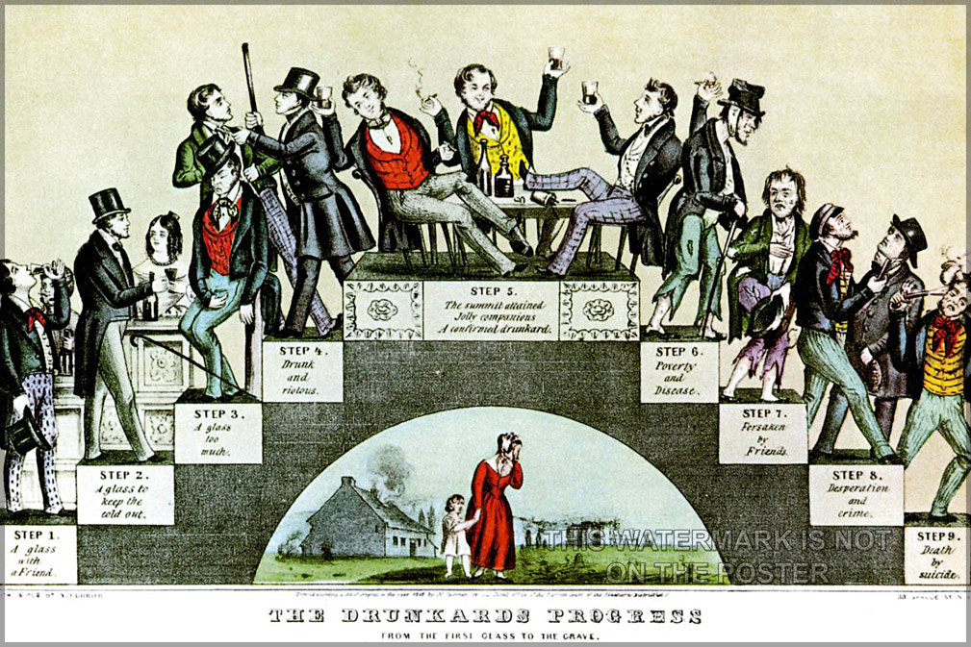
Influences of the Second Great Awakening (SSUSH7c)
Temperance movement (SSUSH7c)
When: 1825-1860
Who: Mary C. Vaughn and Lyman Beecher
Issue: People should drink less alcohol, or alcohol should be outlawed altogether.
Impact: This movement increased the size of Protestant religious organizations. Women played an important role, which laid the foundation for the women’s movement.

Slide 51
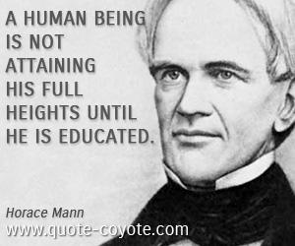
Influences of the Second Great Awakening (SSUSH7c)
Public school movement (SSUSH7c)
When?: 1837-1850
Who?: Horace Mann
Issue: All children should be required to attend free schools supported by taxpayers and staffed by trained teachers.
Impact: This movement established education as a right for all children and as a state and local issue it improved the quality of schools by requiring trained teachers.

Slide 52
What is the Artist trying to summarize with this Picture?

Slide 53
Influences of the Second Great Awakening (SSUSH7c)
Women’s Rights Movement (SSUSH7c)
When?: 1848-1851
Who?: Elizabeth Cady Stanton and Lucretia Mott
Issue: Women did not have the right to vote (suffrage) and often lacked legal custody of their own children in the early 1800s.
Impact: Elizabeth Cady Stanton was an outspoken advocate for women’s full rights of citizenship, including voting rights and parental and custody rights.
In 1848, she organized the Seneca Falls Conference––America’s first women’s rights convention––in New York.
The Seneca Falls Conference marked the beginning of organized efforts by women in the United States to gain civil rights equal to those of men.

Slide 54
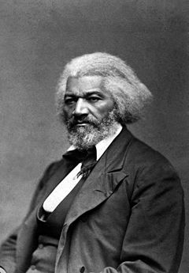
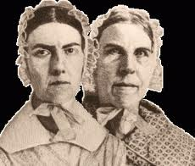
Which of the following would you listen to, about the issue of slavery?

Slide 55
Rise of the Abolitionist Movement (SSUSH7c)
Abolitionist movement
When?: 1820-1865
Who?: Frederick Douglass, William Lloyd Garrison, Sarah and Angelina Grimke, David Walker, Nat Turner, John Brown
Issue: Slavery should be abolished and it should not be allowed in new states.
Impact: This movement made slavery and its expansion an important political issue.
The significance of slavery grew in American politics as a result of slave rebellions and the rise of the abolitionist movements.

Slide 56
What is the artist trying to summarize with the following image?

Slide 57
Nat Turner’s Rebellion (SSUSH7c)
African American preacher Nat Turner believed his mission was to free his people from slavery.
Turner led a violent slave rebellion on four Virginia plantations and they killed 60 whites.
Turner was captured, tried, and executed.
To stop such slave uprisings, white leaders passed new laws limit the rights of slaves.

Slide 58
Review Questions
List three items include in Henry Clay’s American System.
What was the industrial and economic purpose of the American System?
What was the significance of the Second Great Awakening?
List for reform movements included in the Second Great Awakening?
What was the importance of the temperance movement?
What was the purpose of the Seneca Falls Conference?
Why did slavery become an import political issue in America?
Define: Abolitionism

Slide 59
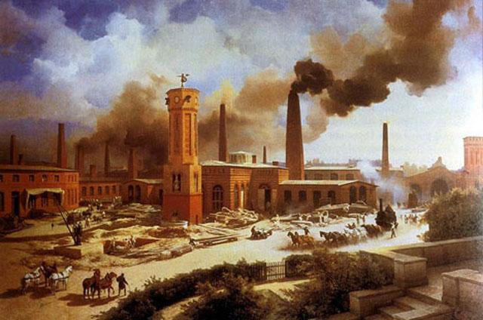
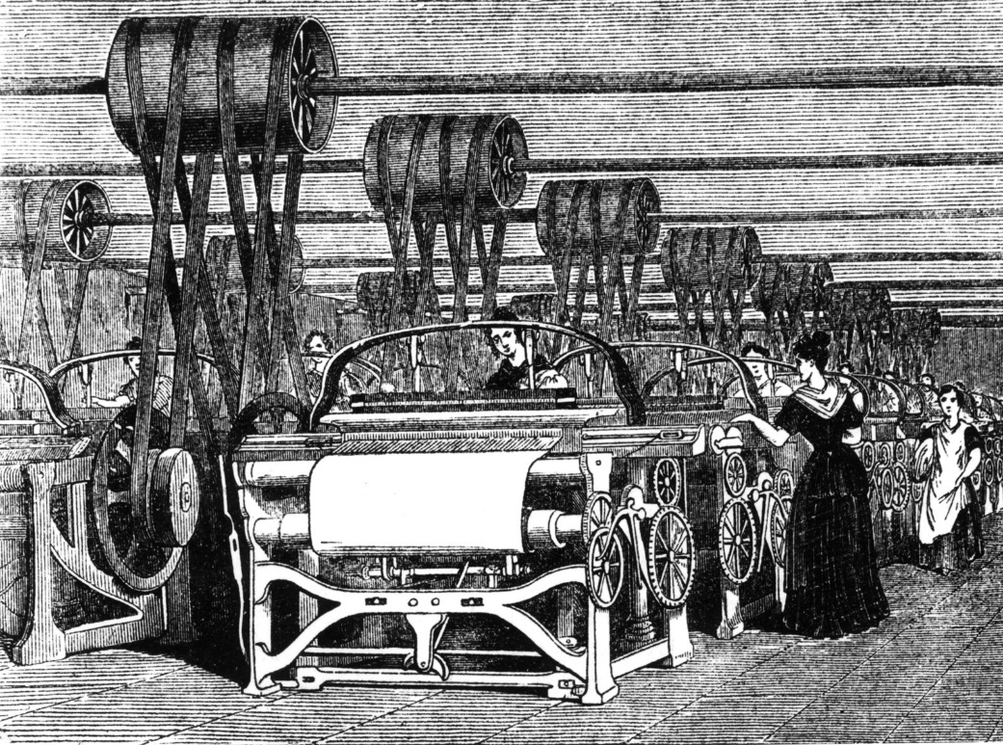
Industrial Revolution (SSUSH7B)
-The era known as the Industrial Revolution began in Britain in the 18th century and made its way to the U.S. in 1793 with the completion of Samuel Slater’s water powered textile mill in Rhode Island
-During the Industrial Revolution the country began to transform from purely agrarian to a modern industrial and commercial economy.
-Hand-made goods were replaced with mass-produced factory made goods made by power driven machines operated by unskilled workers
-The nation had abundant resources in the south, waterpower from swift rivers to operate factories in the north, a growing immigrant population to work in the factories, and new methods of transportation to connect the farms, factories, and markets across the country

Slide 60
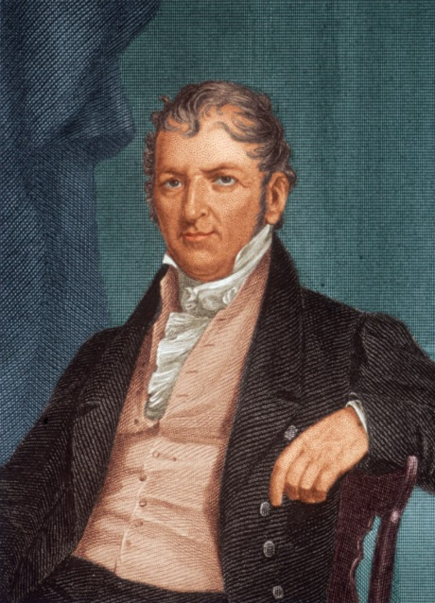
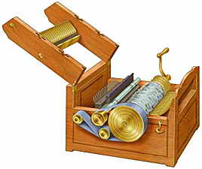
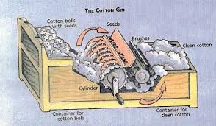
Cotton Gin (SSUSH7D)
-Prior to the cotton gin, slavery was nearly dead in the upper south
-The cotton gin and westward expansion revived slavery
-Eli Whitney invented the cotton gin in 1793
-It is a machine that rapidly removes cotton plant seeds from the valuable cotton fiber used to make thread and fabric
-By producing more cotton in a day than any person could clean by hand, the gin reduced the cost of processing cotton and greatly raised profit from growing it
-Slaves were often put to work running the cotton gins and to do the hard labor of growing and picking the cotton
https://www.youtube.com/watch?v=0SMNYivhGsc

