Slide 1
The Constitution
U.S. History-Unit 3

Slide 2
Standards
SSUSH5 Investigate specific events and key ideas that brought about the adoption and implementation of the United States Constitution.

Slide 3
Key Concepts
The Articles of Confederation
Land Ordinance of 1785
The Northwest Ordinance of 1787
Daniel Shays’ Rebellion
The Constitution
The Great Compromise
Limited Government
Separation of Powers
Checks and Balances
Three-Fifths Compromise
Ratification
Federalist
James Madison
Alexander Hamilton
The Federalist Papers
Anti-Federalist
Thomas Jefferson
The Bill of Rights
First Amendment
Ninth Amendment
Tenth Amendment

Slide 4
The Articles of Confederation (SSUSH5a)
Following the adoption of the Declaration of Independence, the newly independent states were cautious about giving too much authority to a central (national or federal) government.
They preferred a confederation, in which each state would maintain its sovereignty while being loosely unified as a nation.
For this reason, Congress drafted the Articles of Confederation. The Articles of Confederation became the first national government in America.

Slide 6
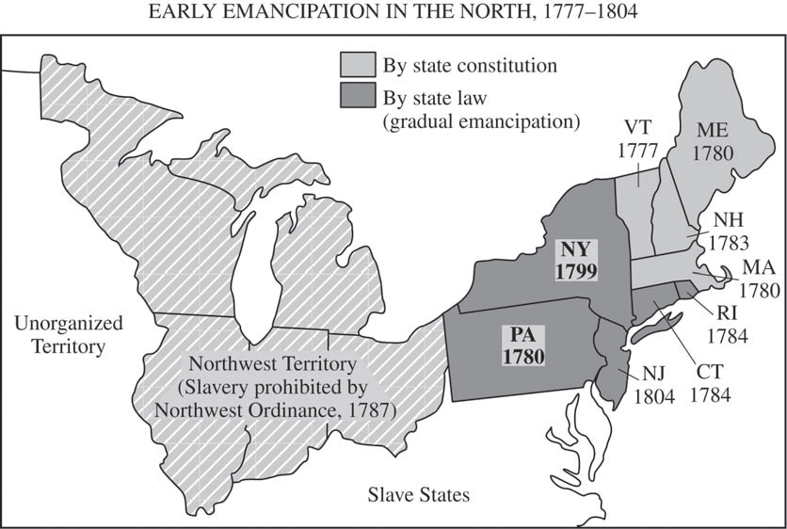

Slide 7
The Strengths in the Articles of Confederation (SSUSH5a)
Two of the strengths of this new national government were the Land Ordinance of 1785 and the Northwest Ordinance in 1787.
The Land Ordinance of 1785 set forth how the government of the United States would measure, divide and distribute the land it had acquired from Great Britain north and west of the Ohio River at the end of the American Revolution.
The Northwest Ordinance of 1787 divided the area into smaller territories and provided guidelines under which new states could be admitted to the union.

Slide 8
The Strengths in the Articles of Confederation (SSUSH5a)
4 Benefits of the Northwest Ordinance
Government encouraged westward migration (Manifest Destiny)
Emancipated (freed) the slaves in the new territory
Made laws for admitting new states into the Union such as Ohio, Indiana, Illinois, Michigan, and Wisconsin.
Mandated the establishment of public schools in the Northwest Territory

Slide 9
The Strengths in the Articles of Confederation (SSUSH5a)
One negative of the Northwest Ordinance was that is led to growing sectionalism between the north and south due to the issue of slavery.

Slide 10
List three or more items that might cause rough sailing for the Articles of Confederation?

Slide 11
Primary Source Analysis
“The consequences of a . . . [an] inefficient government are too obvious to be dwelt upon. Thirteen sovereignties pulling against each other, and all tugging at the federal head, will soon bring ruin upon the whole. . . . Let us have [government] by which our lives, liberty, and property will be secured or let us know the worst at once.”
Source: From a letter by George Washington to a friend

Slide 12
The Weaknesses in the Articles of Confederation (SSUSH5b)
The Articles of Confederation showed that Americans’ feared a powerful national (Federal or central) government.
As a result, the Articles created a government that had
no executive branch or judicial branch
lacked the power to tax
could not regulate commerce
no ability to establish a national currency
gave power to the states governments (not the national government)

Slide 13
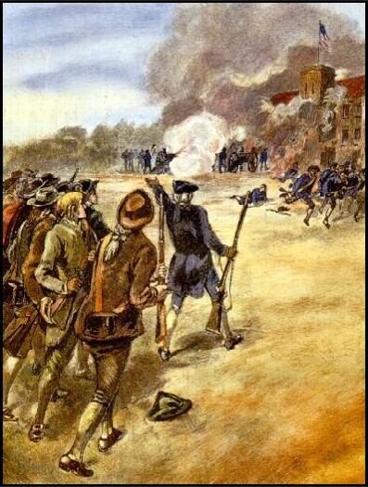
The Weaknesses in the Articles of Confederation (SSUSH5b)
The Articles of Confederation resulted in a weak national (Federal or central) government and convinces Americans that then needed a new government.

Slide 14
Daniel Shays Rebellion (SSUSH5b)
Daniel Shays led more than a thousand farmers who, like him, were burdened with personal debts caused by economic problems stemming from the Revolutionary War debts. Shays and his men tried to seize a federal arsenal in Massachusetts.
Without the power to tax, America and the Articles of Confederation could not repair the national economy.
As a result of Shays’s Rebellion, Americans began to support the establishment of a stronger national (Federal or Central) government.

Slide 15
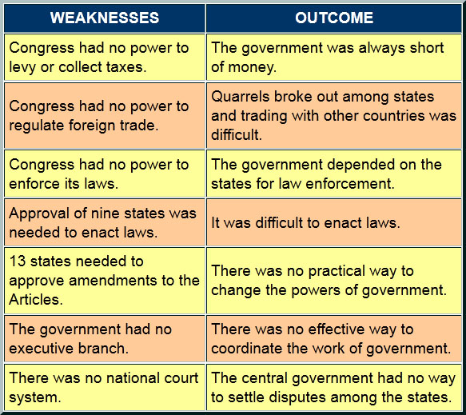

Slide 16
Review Questions
What were the Articles of Confederation?
List two benefits of the Articles of Confederation.
List four benefits of the Northwest Ordinance.
List three negative of the Articles of Confederation.
How did Daniel Shay’s Rebellion impact the Articles of Confederation?

Slide 17
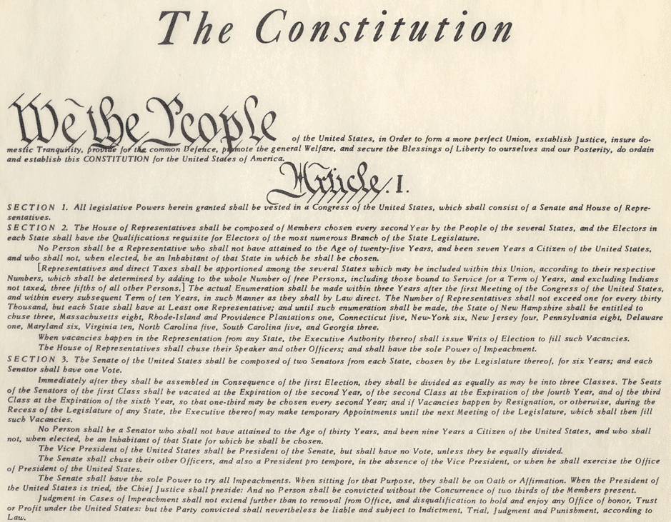
The Constitution (SSUSH5c)
In May of 1787, George Washington was elected president of the Constitutional Convention in Philadelphia, where he and the Founding Fathers created the United States Constitution.
The United States Constitution created a new national (Federal or Central) government.

Slide 18
Primary Source Analysis
The diversity of opinions turns on two points. If a proportional (population) representation takes place, the small states contend that their liberties will be in danger. If an equality of votes is to be put in its place, large states say that their money will be in danger. . . . When a broad table is to be made and the edges of a plank do not fit, the artist takes a little from both sides and makes a good joint. In like manner, both sides must part with some of their demands, in order that they both join in some accommodating position.
Source: Ben Franklin on the Great Compromise

Slide 19
First Constitutional Battle Why did the states battle over representation in the government?

Slide 20
The Great Compromise (SSUSH5c)
One great issue facing the delegates to the Constitutional Convention was how different sized states could have equal representation in the new government.
States with large populations supported the Virginia Plan. This plan created a legislative branch in which representatives were assigned based on each state’s population (Today: California has 53 representatives, Georgia has 14 representatives).
States with smaller populations supported a New Jersey Plan. This plan created a legislative branch in which all states were equally represented (2 representatives for each state).

Slide 21
The Great Compromise (SSUSH5c)
Delegates to the Constitutional Convention settled the issue of representation in Congress by approving the Great Compromise.
The Great Compromise called for the creation of a legislature with two chambers (Bi-cameral): a House of Representatives, with representation based on population, and a Senate, with equal representation for all states.

Slide 22
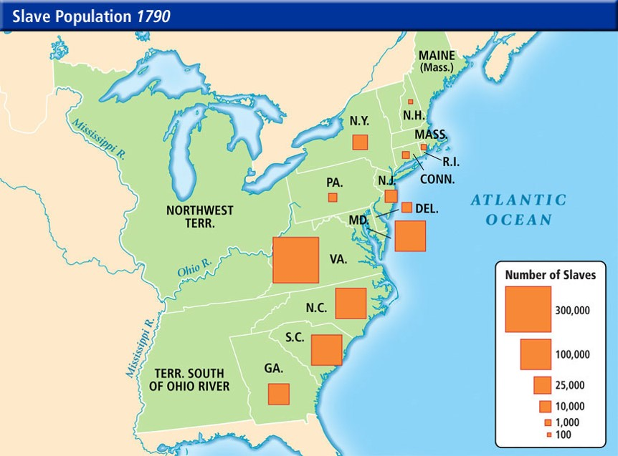
Second Constitutional Battle Which states would like to count slaves as part of their population?

Slide 23
Three-Fifths Compromise (SSUSH5c)
Though slavery existed in all the states, southern states depended on slave labor because their economies were based on producing cash crops.
When it became clear that states with large populations might have more representatives in the new national government, states with large slave populations demanded to be allowed to count their slaves as a part of their population. Northern states resisted.
Both sides compromised by creating the Three-Fifth Compromise.
The Three-Fifth Compromise: allowed the states to count three-fifths of their slaves when calculating their entire population.

Slide 24
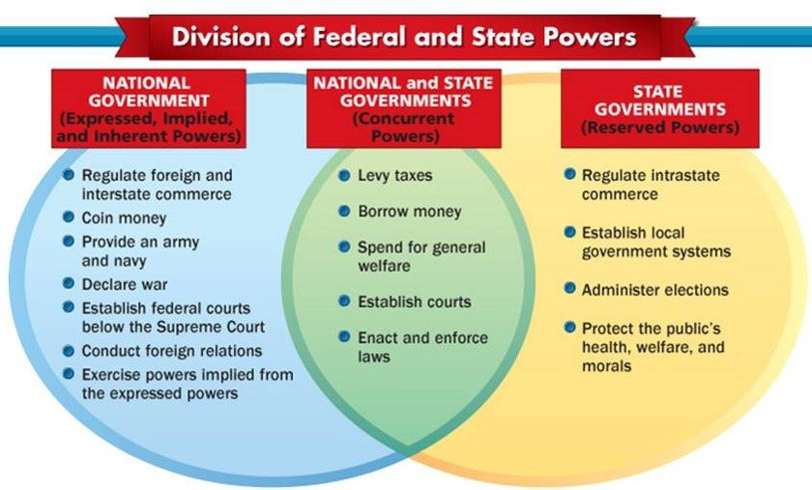
Federalism (SSUSH5c)
Federalism: Power is divided and shared between the national and state governments.

Slide 25
Primary Document Analysis
“The individual can be free only when the power of one governmental branch is balanced by the other two.”
Source: Baron de Montesquieu, 1735

Slide 26
Limits on the Power of the Constitution and Federal Government

Slide 27
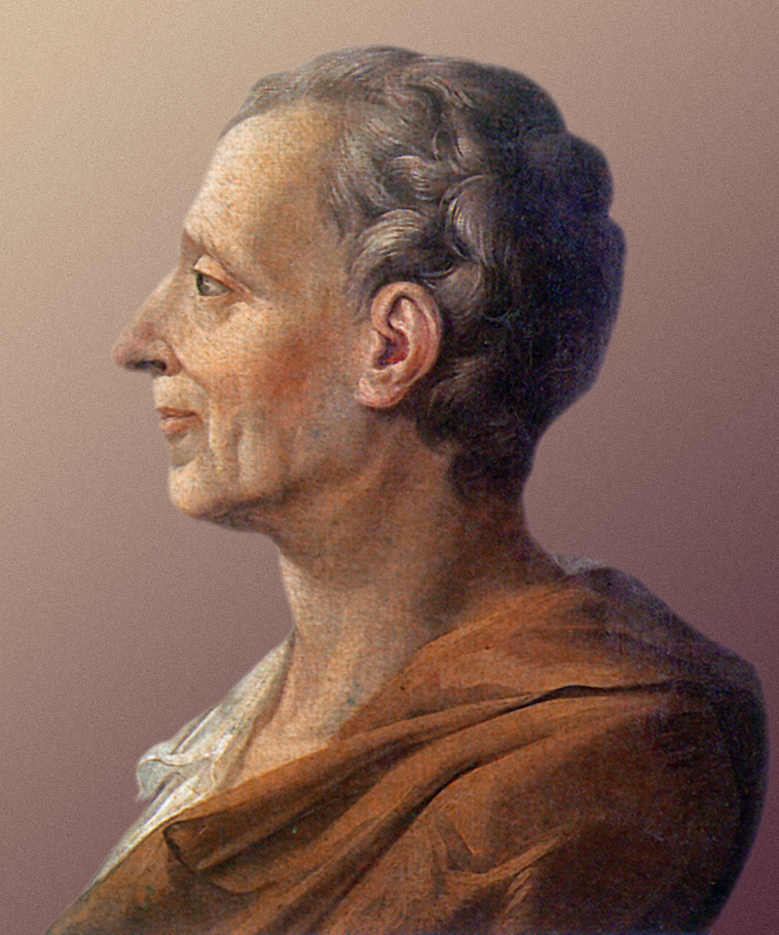
Separation of Powers (SSUSH5c)
Created by French political thinker Baron Charles de Montesquieu.
Separation of Powers limits the federal government’s power by creating a legislative, executive, and judicial branch of government.

Slide 28
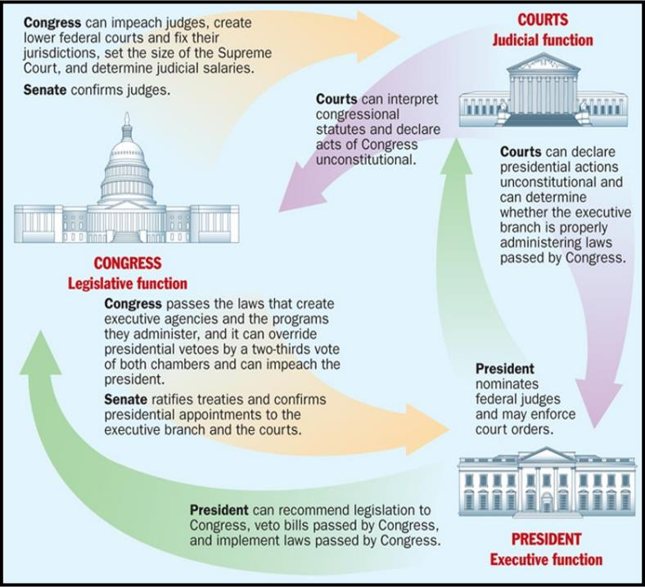
Limits on the Power of the Constitution and Federal Government

Slide 29
Checks and Balances (SSUSH5c)
Checks and Balances: limits the national government by balancing the power between the legislative, executive and judicial branch by giving each branch certain powers over the other branches.
For example, the legislature can override a presidential veto of a bill, and the Supreme Court can rule that a bill signed by the president is unconstitutional.

Slide 30
Review Questions
What was the purpose of the Constitution?
How did the Great Compromise solve the issue of state representation in the new federal government?
How did the Three-Fifths Compromise solve the issue of state representation in the new federal government?
List two limits to the power of the federal government in the Constitution.
Define: Separation of Powers
Define: Checks and Balances

Slide 31
Why was the ratification of the Constitution so significant?

Slide 32
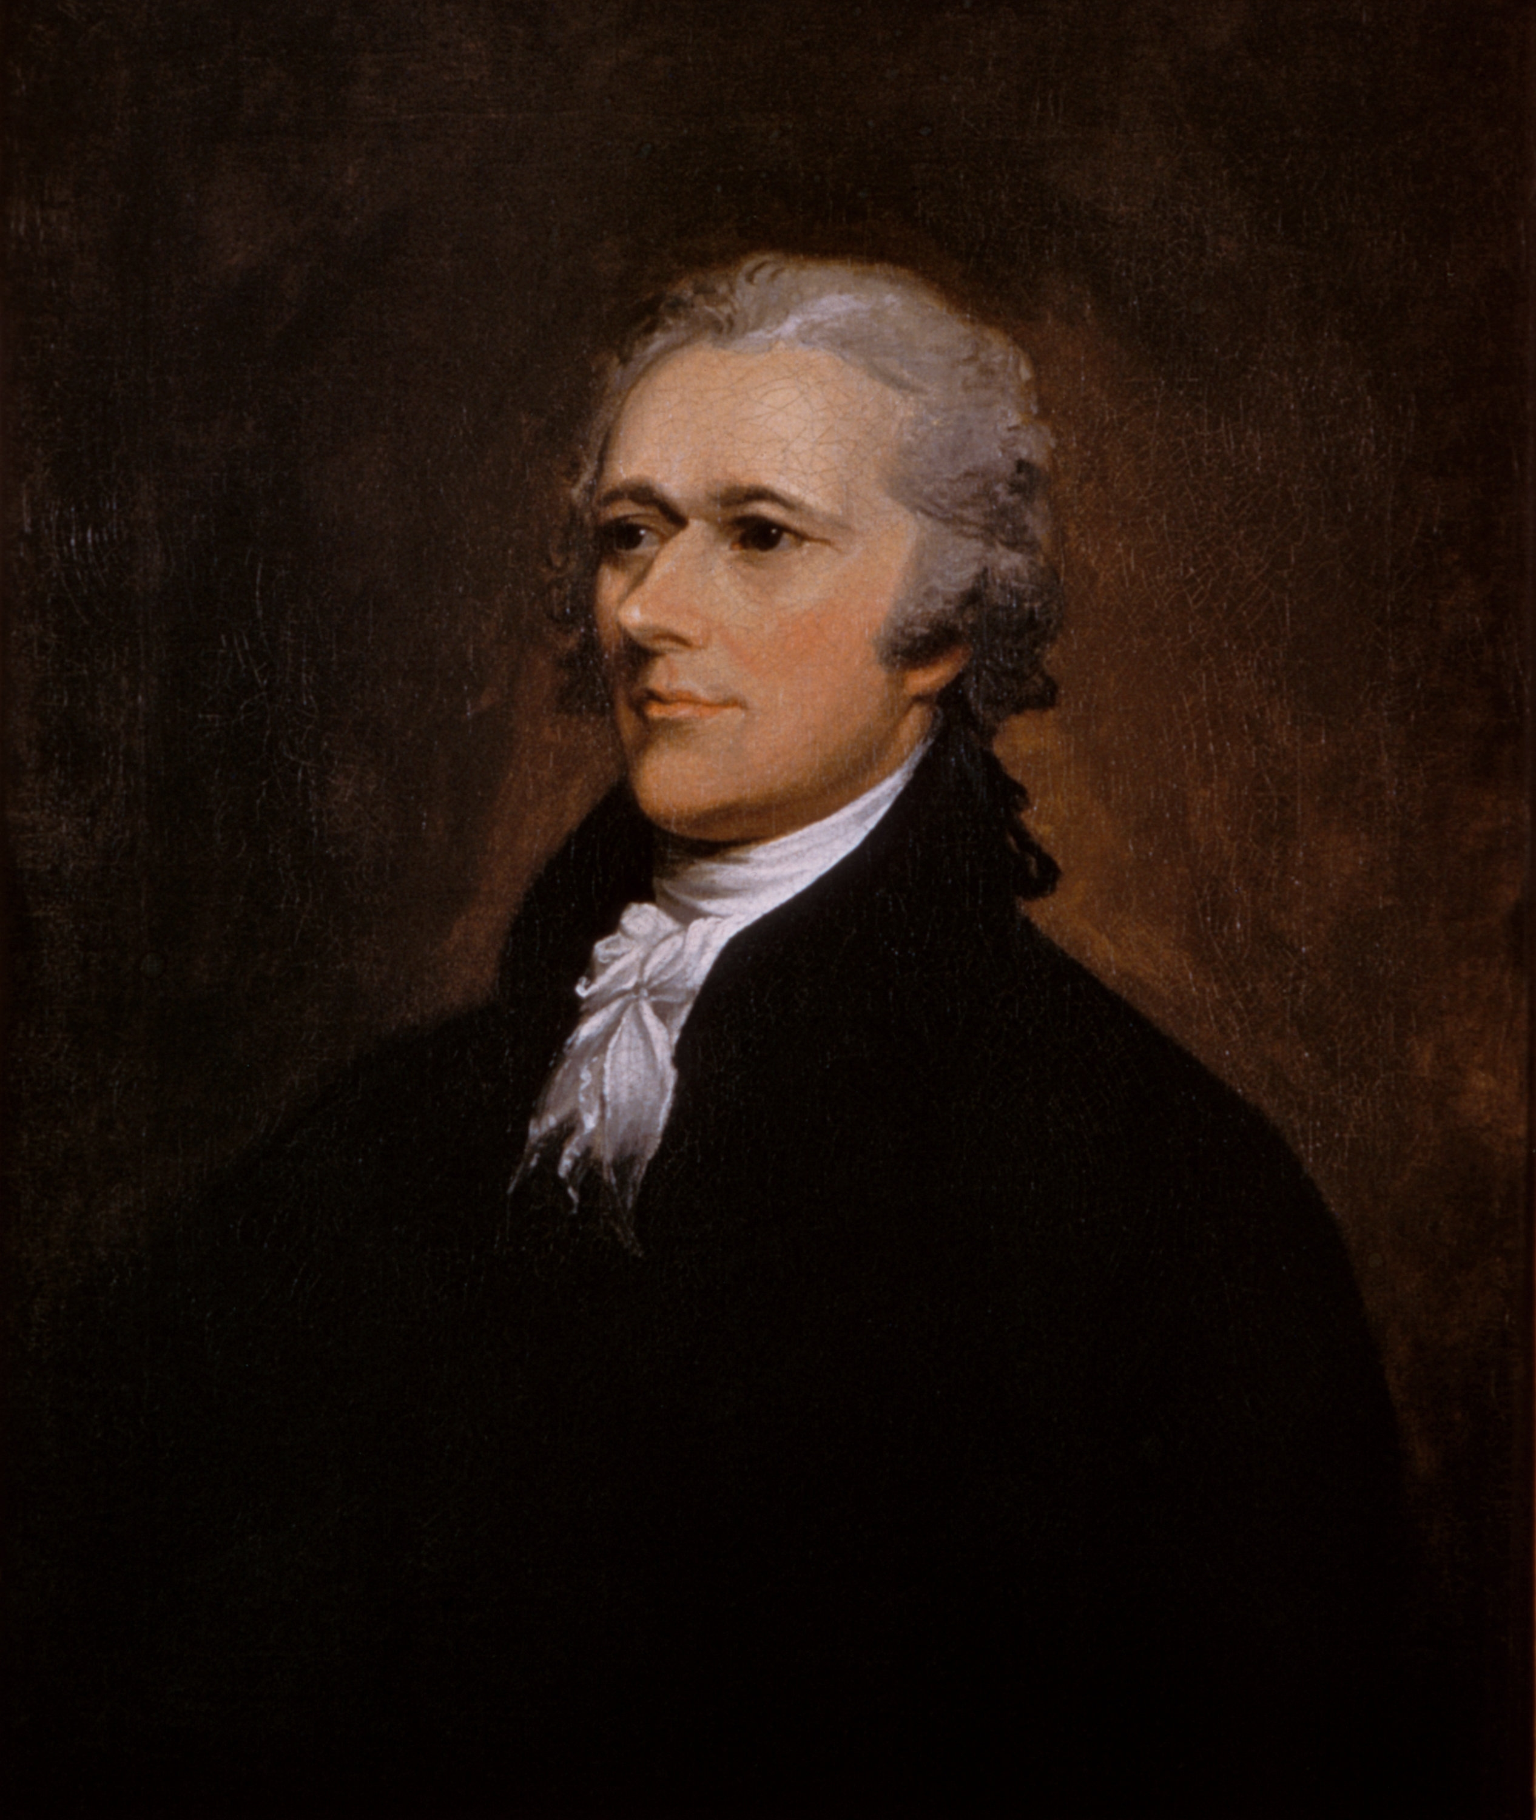

Slide 33
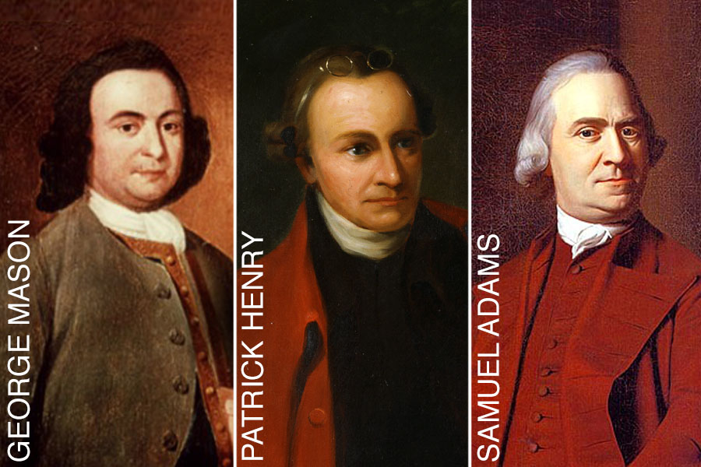
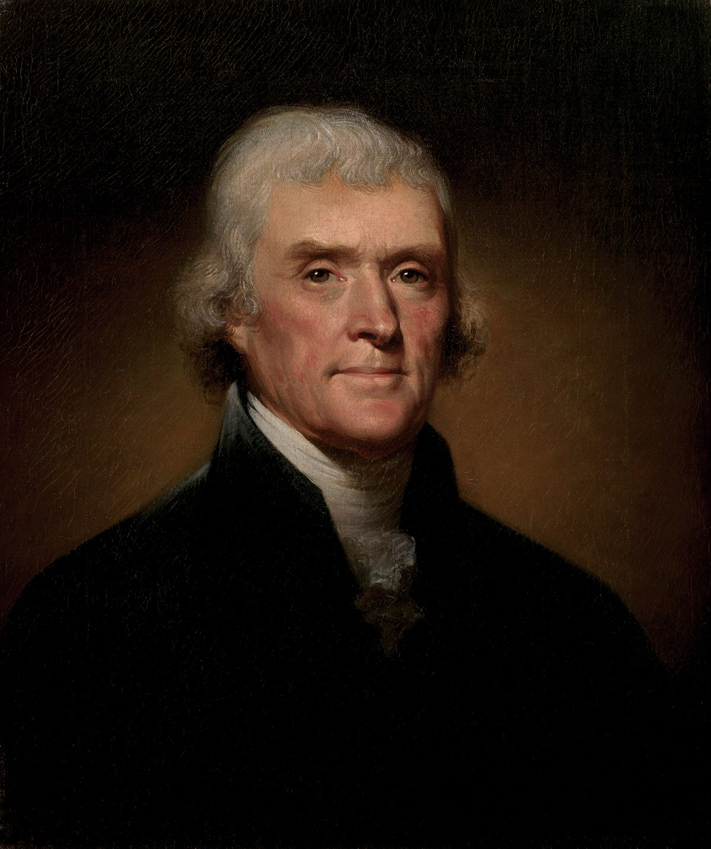
ANTI-FEDERALISTS

Slide 34
Role of the Federalists and Anti-Federalists (SSUSH5d)
As soon the Constitution was published, the Federalists and the anti-Federalists began to argue of the contents of the document
The Federalists and James Madison wanted the Constitution and a strong national (federal or central) government.
The Anti-Federalists and Thomas Jefferson believed the government created by the Constitution would be too powerful and would eliminate the power of the states.
The Anti-Federalists also argued that the Constitution did not have a Bill of Rights to describe the rights guaranteed to the states and to each citizen.

Slide 35
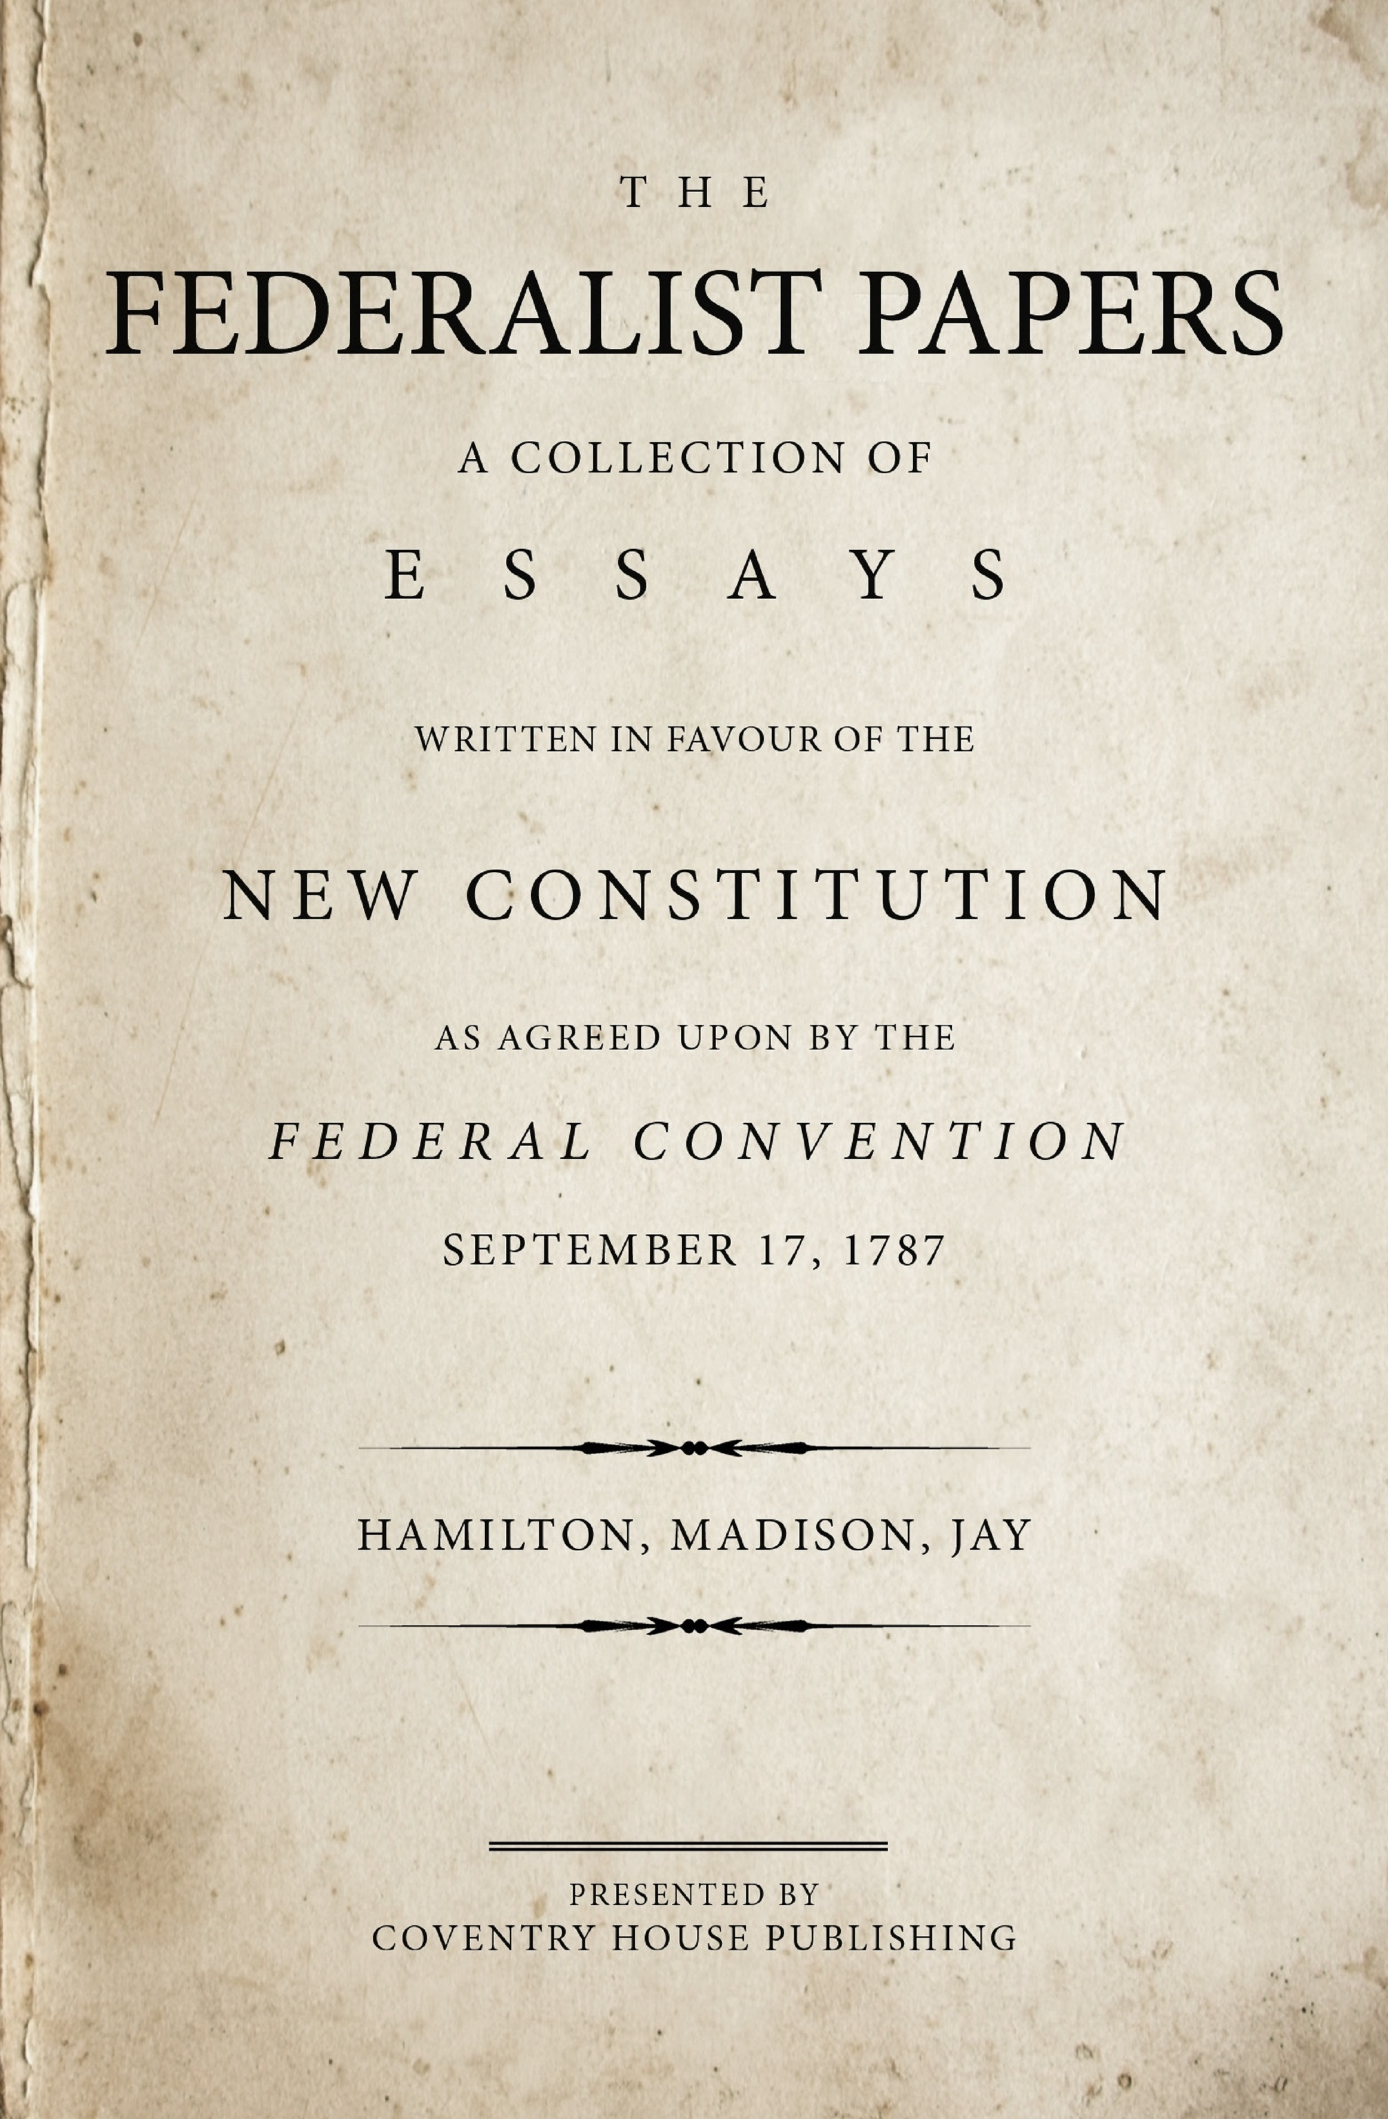
The Federalist Papers (SSUSH5d)
To counter these claims of the anti-Federalist, James Madison, Alexander Hamilton, and John Jay wrote The Federalist Papers that supported ratification of the Constitution and explained the intent behind its major provisions.
James Madison also wrote the Bill of Rights to be added to the Constitution after it was ratified.
Madison also believed federalism should be used as a tool to limit the power of the federal government.
The Constitution was eventually ratified and became the basis for all law, rights, and governmental power in the United States.

Slide 37
Primary Source Analysis
“I do not like the omission of a bill of rights providing clearly and without the aid of sophisms for freedom of religion, against monopolies, the eternal and unremitting force of the habeas corpus laws, and trials by jury....A bill of rights is what the people are entitled to against every government on earth, general or particular, and what no just government should refuse or rest on inference....I hope therefore bill of rights will be formed to guard the peoples against the federal government, as they are already guarded against their state governments in most instances.”
Source: Letter from Thomas Jefferson, Virginia landowner, to James Madison:

Slide 39
The Bill of Rights (SSUSH5e)
The Bill of Rights is the first 10 amendments to the Constitution and they guarantee states’ rights and individuals’ rights.
1st Amend: Guarantees freedom of religion, of speech, and of the press, and the right to petition the government
9th Amend: Declares that rights not mentioned in the Constitution belong to the people
10th Amend: Declares that powers not given to the national government belong to the states or to the people

Slide 40
Review Questions
What were the political believes of the Anti-Federalist?
List two famous Anti-Federalist
What were the political believes of the Federalist?
List two famous Federalist.
Define: Ratification
What was the purpose of the Federalist Papers?
What did the Anti-Federalist want added to the Constitution, in exchange for ratifying the Constitution?
What was the purpose of the Bill of Rights?

