Slide 1
American Revolution
Unit 2- U.S. History

Slide 2
Standards
SSUSH3 Analyze the causes of the American Revolution.
SSUSH4 Analyze the ideological, military, social, and diplomatic aspects of the American Revolution.

Slide 3
Key Concepts
French and Indian War
1763 Treaty of Paris
Proclamation of 1763
The Stamp Act
The Intolerable Acts
Sons of Liberty
Daughters of Liberty
Committee of Correspondence
Importance of Thomas Paine
Declaration of Independence
Thomas Jefferson
Committee of Five
John Lock
Natural Rights
Social Contract
George Washington
Baron von Steuben
Marquis de Lafayette
Valley Forge
Battle of Trenton
Battle of Saratoga
Battle of Yorktown
The Treaty of Paris, 1783

Slide 5
The French and Indian War (SSUSH3a)
The desire for territory produced by mercantilism also meant that nations ended up fighting over land and resources.
As British colonists moved west into the Ohio Valley, they found themselves fighting French settlers and Native Americans.
In 1754, this tension between French and British colonials resulted in the French and Indian War.

Slide 6
The French and Indian War (SSUSH3a)
It was so named because Britain fought the war against France and its Native American allies (some Native Americans helped the British).
Native Americans tended to support the French because, as fur traders, the French built forts rather than permanent settlements.

Slide 7
The 1763 Treaty of Paris (SSUSH3a)
After nine years of fighting, France, Great Britain, and Spain (a French ally) signed the Treaty of Paris in 1763.
France gave up its claims in Canada and all lands east of the Mississippi River.
Great Britain now stood alone as the one, true colonial power in eastern North America.

Slide 8
The 1763 Treaty of Paris (SSUSH3a)
The British claimed they were protecting the Colonists during the War and therefore the Colonists needed to repay the British for protection.
Colonists and British tension grew when the English Parliament passed laws to tax the colonists to pay for the cost of keeping a large standing army in North America that would protect both Britain’s possessions and the American colonists from attacks.

Slide 9
Why did the British Draw the Proclamation Line of 1763?

Slide 10
How did the colonist respond to the British Enforced Proclamation Line?

Slide 11
Proclamation of 1763 (SSUSH3b)
Great Britain now possessed vast new territories and felt that it needed to find a way to control them.
As a result, it took a number of steps the colonists found offensive.
The first was the king's Proclamation of 1763.
It forbade colonists from settling west of the Appalachian Mountains and put the territory under British military control. The proclamation was intended to manage Britain's new territories and ensure peace with Native Americans.

Slide 12
Use the Cartoon to determine, Why the Colonist Are Upset?

Slide 13
The Stamp Act (SSUSH3b)
Beginning in the mid 1760s, Parliament passed a series of laws and taxes that infuriated the Americans.
One of the most offensive was the Stamp Act.
Under this law, the British government taxed nearly all printed material by requiring that it bear a government stamp.

Slide 14
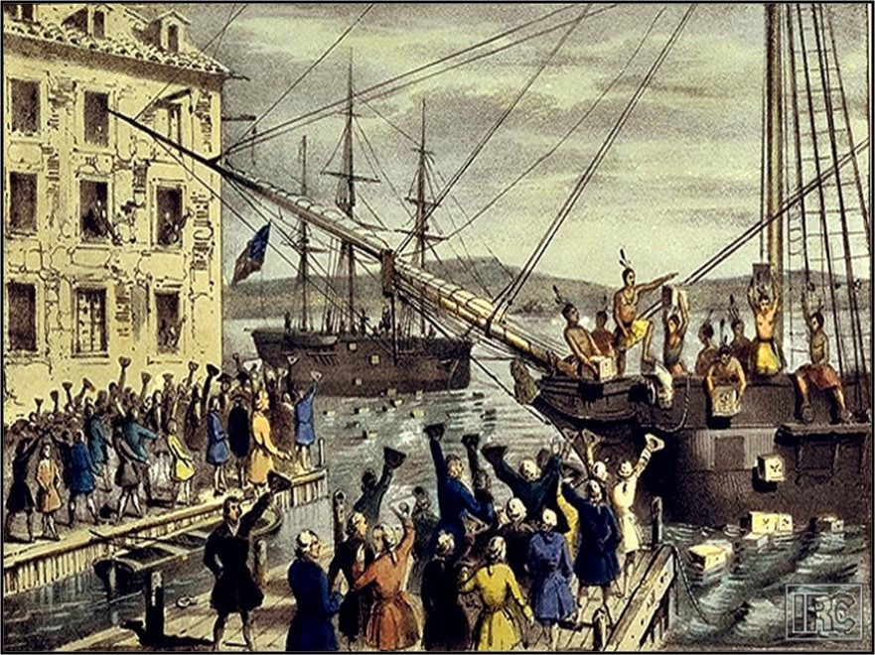

Slide 15
The Intolerable Acts (SSUSH3b)
The Intolerable Acts closed the port of Boston as punishment for the Boston Tea Party.
These acts also allowed British officials accused of major crimes to be tried in England and forced the colonists to house British troops on their property.
Colonists called for the Continental Congress to protest these actions and formed colonial militias to resist enforcement of these acts.

Slide 16
Review Questions
What countries participated in the French and Indian War?
What was the significance of the 1763 Treaty of Paris?
How did the French and Indian War and the1763 Treaty of Paris lay the groundwork for the American Revolution?
What was the significance of the Proclamation of 1763?
What was the significance of the Stamp Act?
What was the significance of the Intolerable Acts?

Slide 17
Primary Source Analysis
“For if our trade be taxed why not our lands and everything we possess and make us of? This and everything we possess and make use of? This we apprehend annihilates our charter Right to govern and tax ourselves. It strikes at our British privileges, which as we never forfeited them we hold in common with our fellow subjects and are natives of Britain. If taxes are laid upon us in any shape without our having a legal representation where they are laid, and we not reduced from the character of free subjects to the miserable state of tributary slaves?”
Sources: Resolution adopted in Boston, May 1764

Slide 18
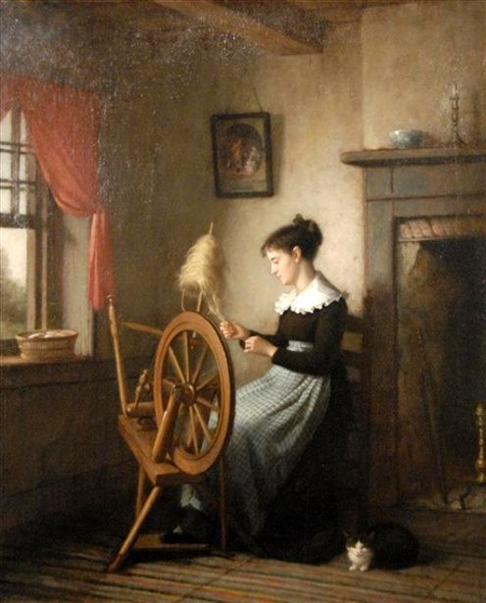

Slide 19
Sons And Daughters of Liberty (SSUSH3b)
The Sons of Liberty often used violence to intimidate any merchant or royal official who might otherwise use the stamps.
Daughters of Liberty often used their skills to weave fabric and other products that were usually bought from Britain, to help support boycotting of British goods.

Slide 20
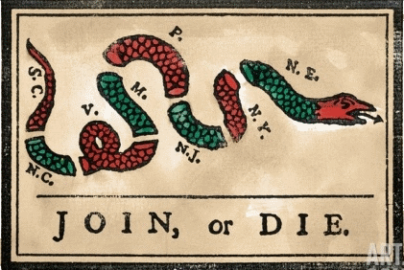

Slide 21
The Committees of Correspondence (SSUSH3b)
The Committees of Correspondence were created as a direct response to the Intolerable acts
The Committees of Correspondence were the first organization linking the 13 colonies in their opposition to British rule.
The committee was instrumental in the planning for the First Continental Congress

Slide 22
Summarize the following Statements
The Atlantic Ocean was too wide to allow Britain to rule America as well as an American government could
It was foolish to think an island could rule a continent
The idea of Britain being America’s “mother country” made Britain’s actions all the worse because no mother would treat her children so badly.

Slide 23
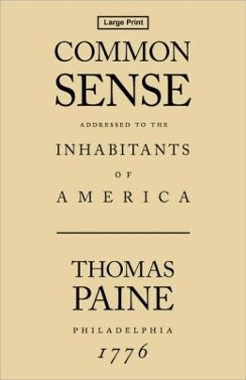
Thomas Paine’s Common Sense (SSUSH3c)
In January 1776, patriot philosopher Thomas Paine published Common Sense.
Paine’s small pamphlet moved many colonists to support independence from Great Britain.

Slide 24
Review Questions
List two colonial groups that were created as a response to the Proclamation of 1763, the Stamp Act and the Intolerable Acts?
Define: Committees of Correspondence
Define: Sons and Daughters of Liberty
Who wrote the pamphlet Common Sense?
What was the significance of Thomas Paine’s pamphlet Common Sense?

Slide 25
Primary Source Analysis
For Quartering large bodies of armed troops among us:
For protecting them, by a mock Trial, from punishment for any Murders which they should commit on the Inhabitants of these States:
For cutting off our Trade with all parts of the world:
For imposing Taxes on us without our Consent:
For depriving us in many cases, of the benefits of Trial by Jury:
For transporting us beyond Seas to be tried for pretended offences
Source: Declaration of Independence, 1776, Retrieved from http://www.constitution.org/us_doi.pdf

Slide 26
Why would an Artist Draw the following Image?

Slide 27
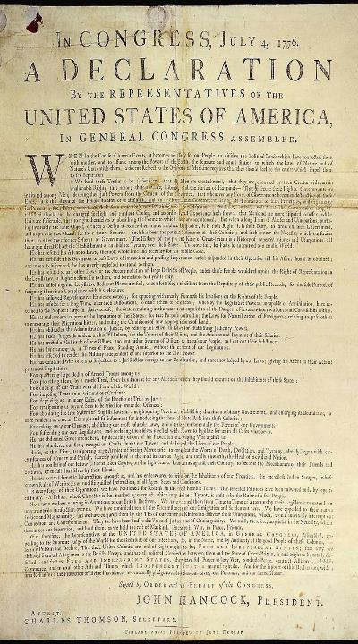
The Declaration of Independence (SSUSH4a)
In June 1776, the delegates to the Second Continental Congress decided to declare independence from Great Britain.
They appointed a committee to prepare a Declaration of Independence that would outline the reasons the colonist wanted to separate from British rule.
The Committee of Five was made up of Thomas Jefferson, Robert Livingston, Ben Franklin, John Adams and Roger Sherman

Slide 28
The Declaration of Independence (SSUSH4a)
Thomas Jefferson wrote the first draft of the Declaration of Independence.
The Declaration of Independence borrowed phrases from the influential writings of English enlightenment philosopher John Locke.

Slide 29
According to the Social Contract Theory, Who or what gives power to the Government? What does the government provide for the people?

Slide 30
The Declaration of Independence (SSUSH4a)
Two of Locke’s philosophies
Natural Rights: All people have the right to life, liberty, and property
Thomas Jefferson said: Life, liberty and the pursuit of happiness
Social Contract: If government does not meet the needs of the people, then the people have a right to overthrow the government or break the contract

Slide 31
Review Questions
Who wrote the Declaration of Independence?
What group helped write the Declaration of Independence?
List the members of the Committee of Five?
What individual influenced Thomas Jefferson and the Committee of Five, when writing the Declaration of Independence?
What was the significance of John Locke’s Natural Rights?
What was the significance of John Locke’s Social Contract?

Slide 32
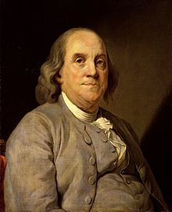
How could these two politicians help America Win the Revolutionary War?

Slide 33
The French Alliance (SSUSH4b)
Another turning point in the Revolutionary War was the decision by France to support the American cause.
Benjamin Franklin and John Adams serving as the American ambassadors to France, convinced the French to form a military alliance with the Americans, and France agreed to wage war against Britain until America gained independence.

Slide 34
Why would an Artist use George Washington in their Political Cartoon?

Slide 35
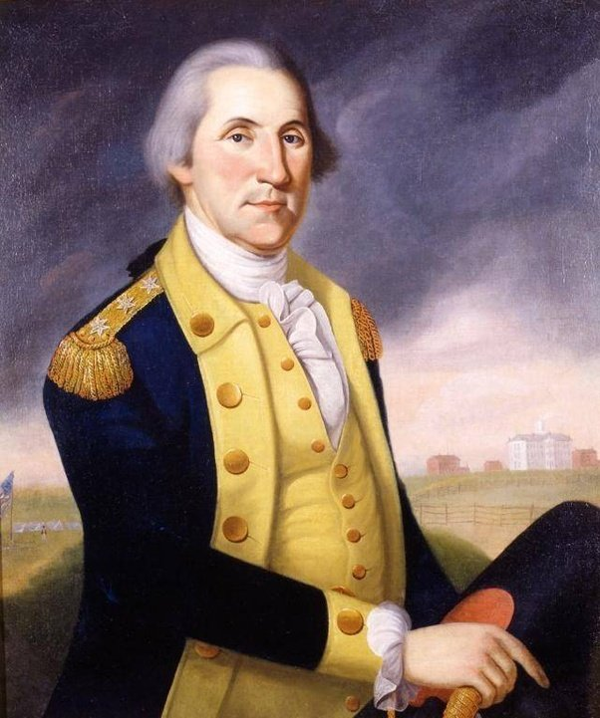
George Washington (SSUSH4c)
When the American Revolution began, George Washington was named commander in chief of the Continental Army.
Washington was able to secure resources and train soldiers to be better than local militias.

Slide 36
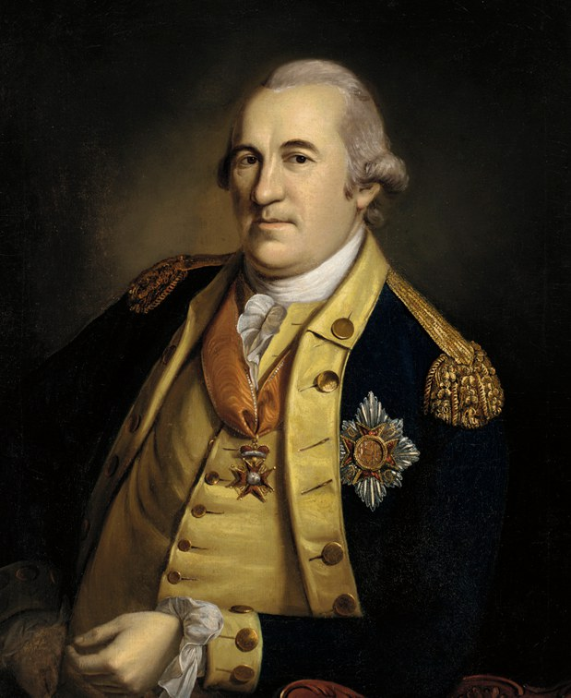
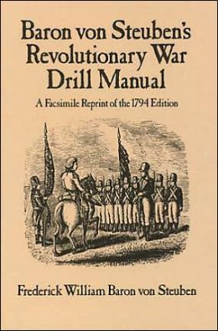
Baron von Steuben (SSUSH4c)
Baron Friedrich Von Steuben, from Prussia, helped Washington effectively used their time at Valley Forge to train the Continental army.
Washington and Steuben started a training program to turn inexperienced recruits into a professional military.

Slide 37
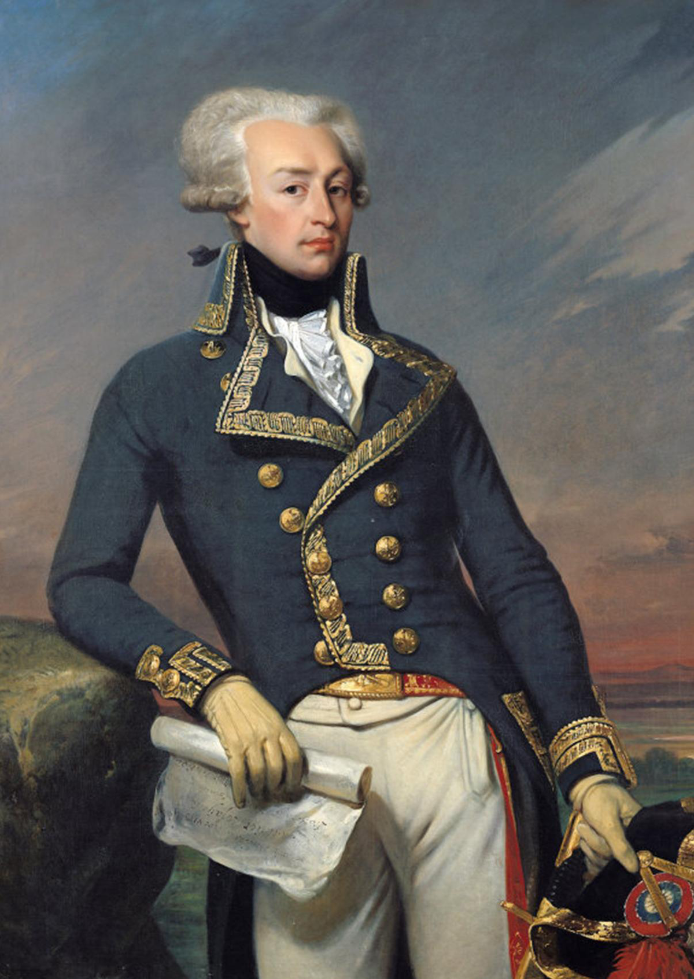
Marquis de LaFayette (SSUSH4c)
Marquis de Lafayette was a French soldier that commanded American troops and fought battles in many colonies

Slide 38
What is the Main Idea of the Next 3 Images?

Slide 42
Valley Forge (SSUSH4c)
Valley Forge: Washington and his troops spent the winter of 1777–1778 in Valley Forge, Pennsylvania.
The troops spent six months at Valley Forge
At Valley Forge the army faced problems with housing, food, clothing, disease and cold weather.
Yet, Washington with the help of Baron von Steuben was able to turn the Continental Army into a stronger military force.

Slide 44
Which of the Next Three Images is The most Historically Accurate?

Slide 48
Battle of Trenton (SSUSH4d)
In December 1776, Washington made a daring move. He surprised his enemy by crossing the Delaware River on Christmas night and attacking the Hessians (Germans hired to fight for the British) and subsequent Battle of Trenton (New Jersey).
Washington's victory in New Jersey greatly lifted American morale and gave people hope that, perhaps, the revolution could actually succeed.

Slide 49
Review Questions
How did Benjamin Franklin and John Adams impact the American Revolution?
What was the role of George Washington during the American Revolution?
What was the significance of Baron von Steuben?
What was the significance of Marquis de LaFayette?
What was the significance of Valley Forge?
What was the geographic significance of the Battle of Trenton?

Slide 50
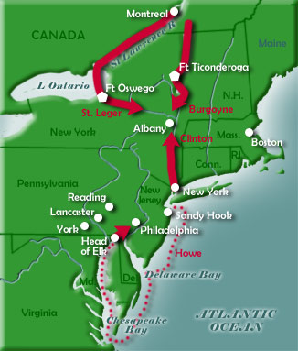

Slide 51
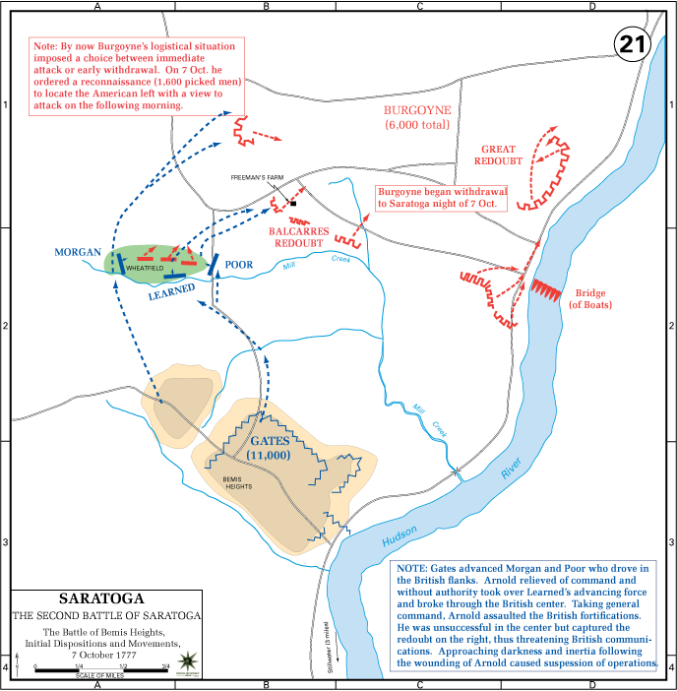

Slide 52
Battle of Saratoga (SSUSH4d)
The British plan to defeat the rebellious Americans was to take control of New York, which would drive a wedge between New England and the rest of the colonies.
British troops are trapped at Saratoga, New York and are waiting for British reinforcements.

Slide 53
Battle of Saratoga (SSUSH4d)
Two geographic advantages of the Colonist
The British reinforcement from Canada were slowed due to the mountains of New York
Controlling the high ground at Bemis Heights with fortifications at the Hudson River
This victory is considered a turning point in the American Revolution because it signaled to France that the Americans had a chance of winning.

Slide 56
Battle of Yorktown (SSUSH4d)
Britain’s plan to counter the French–American alliance was to have General Charles Cornwallis move the war to the southern states to try to separate those colonies from revolutionary forces in the North.
At the Battle of Yorktown, the British forces were attacked by the combined French and American armies and a French fleet.
The combined attack trapped the British forces on a peninsula. Cut-off from any reinforcements, Cornwallis was forced to surrender, and the American Revolution came to an end in North America.

Slide 57
Primary Source Analysis
Despite their low positions in society, women did participate. On the home front, they sewed uniforms and knitted stockings for the soldiers. With their husbands away fighting, some women had to take over as weavers, carpenters, blacksmiths, or shipbuilders. Others transformed their homes into hospitals for the wounded.
Both men and women fought on the battlefield. Hundreds of women served as nurses, laundresses, cooks . . . there were some that actually engaged in battle . . . Deborah Sampson put on men’s clothing and called herself Robert Shirtliffe in order to enlist in the Army. “Robert Shirtliffe” fought courageously; “his” company defeated marauding Indians north of Ticonderoga.
Source—Tina Ann Nguyen, “American Athenas: Women in the Revolution”

Slide 58
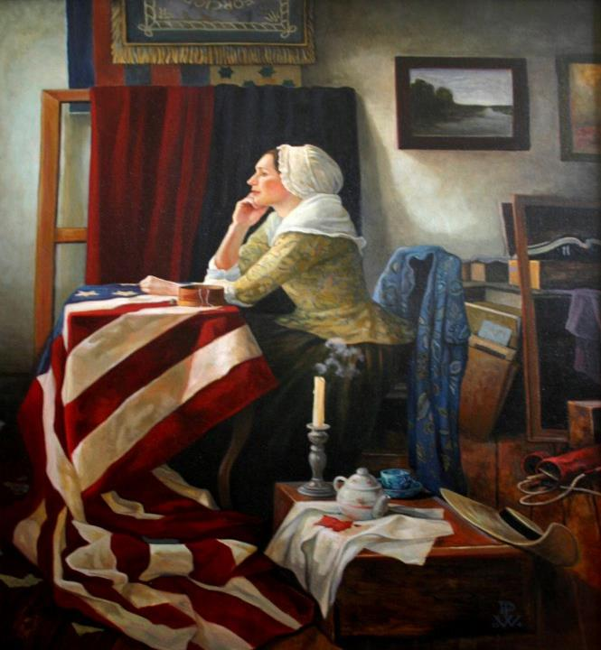

Slide 59
The Roles of Women (SSUSH4e)
Military encampments often included large numbers of women. They were known as “camp followers” and would wash, sew, cook, and nurse the wounded and sick in camp.
Other women served as spies for the Continental Army.
The British Army frequently hired local women to clean, cook, and sew for them.

Slide 60
The Roles of American Indians (SSUSH4e)
American Indians found themselves in a difficult position as the colonists were fighting the British over control of North American lands.
Most of the western American Indians sided with the British in an effort to try to prevent further settlement in the region by American colonists- as was the policy of the British Proclamation of 1763.
Some Americans Indians used their knowledge of the land to help the Continental Army.

Slide 63
The Roles of African-Americans (SSUSH4e)
Enslaved and free Blacks, in many cases, viewed the American Revolution as an opportunity for expanding their own rights with the basis for revolution being a call to protect natural rights.
Estimates suggest at least ,000 enslaved and free Blacks fought with the Patriots.
However, those who fought with the Continental Army and with the colonial militia groups did not receive their freedom following the conclusion of the Revolutionary War.

Slide 65
Primary Source Analysis
Article 1:
His Brittanic (Britain) Majesty acknowledges the said United States, viz., New Hampshire, Massachusetts Bay, Rhode Island and Providence Plantations, Connecticut, New York, New Jersey, Pennsylvania, Delaware, Maryland, Virginia, North Carolina, South Carolina and Georgia, to be free sovereign and independent states, that he treats with them as such, and for himself, his heirs, and successors, relinquishes all claims to the government, propriety, and territorial rights of the same and every part thereof.
Source: Treaty of Paris 1783

Slide 66
The Treaty of Paris, 1783 (SSUSH4f)

Slide 67
Review Questions
What was the geographic significance of the Battle of Saratoga?
What was the geographic significance of the Battle of Yorktown?
What was the role of women during the American Revolution?
What was the role of American Indians during the American Revolution?
What was the role of enslaved and free blacks during the American Revolution?
What was the significance of the Treaty of Paris?

