Slide 1
Modern Politics
Unit 12: U.S. History

Slide 2
Standards
SSUSH22 Analyze U.S. international and domestic policies including their influences on technological advancements and social changes during the Nixon, Ford, and Carter administrations.
SSUSH23 Assess the political, economic, and technological changes since 1981.

Slide 3
Key Concepts
Visits China
War Powers Act
Watergate Scandal
End of Vietnam War
Pardoning of Nixon
The Camp David Accords
Response to 1979 Iranian Revolution
Iran Hostage Crisis
Creation of the Environmental Protection Agency
National Organization of Women
Collapse of the Soviet Union
Bill Clinton’s Impeachment
Attacks of September 11, 2001
War against Terrorism
Reaganomics
Technological Changes
Presidential Election of 2008

Slide 4
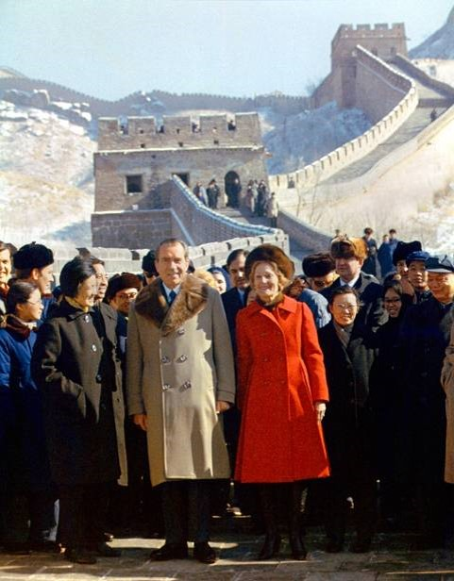

Slide 5
Nixon’s Presidency (SSUSH22a)
Richard Nixon Visits China
Visited China to seek scientific, cultural, and trade agreements
Hoped Chinese and the U.S. would become allies against the Soviet Union
Nixon’s visit led the Soviet Union to abandon support for North Vietnam and agreed to negotiate a nuclear disarmament treaty

Slide 6
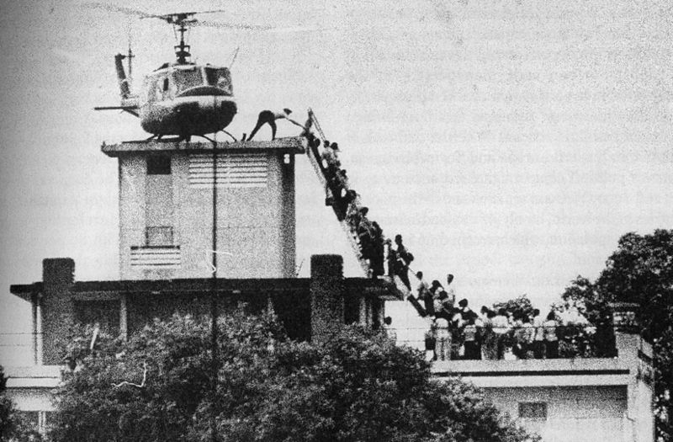

Slide 8
Nixon’s Presidency (SSUSH22a)
End of Vietnam War
The President had been given immense unilateral power through the Gulf of Tonkin Resolution to take any measures he deemed necessary to protect the United States.
The Congress had been powerless through much of the Vietnam War to adjust the level of troop commitment to the region because of the Gulf of Tonkin's unlimited provisions.
Once the war was over, the Congress passed the War Powers Act in 1973.
The provisions of the new policy require the Congress to authorize troop commitments within a certain time frame.
The measure redistributed power to conduct military operations between the executive and legislative branches.

Slide 9
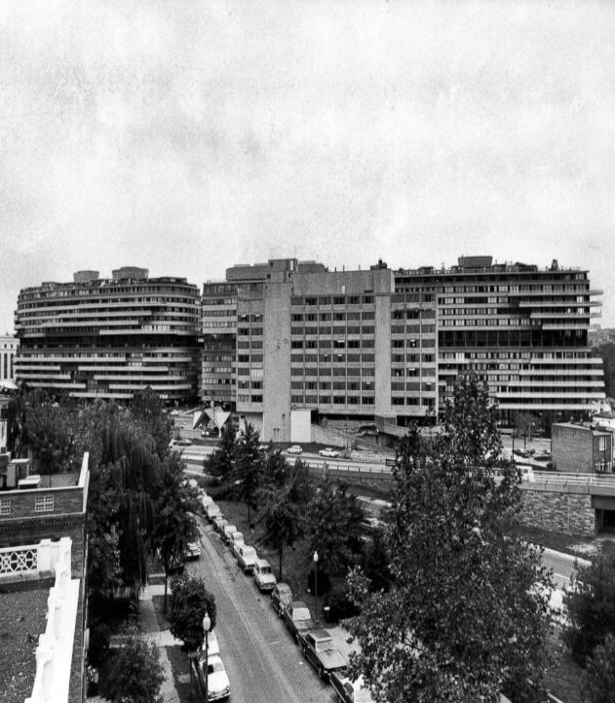
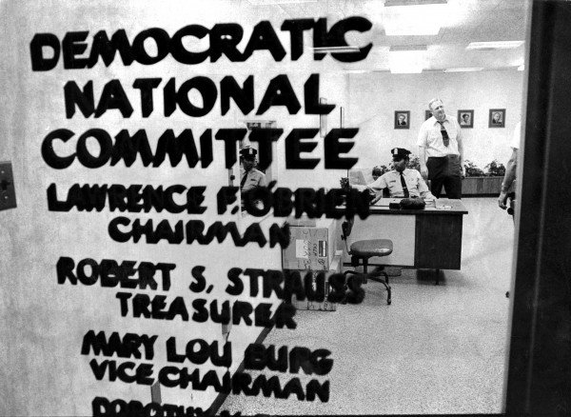

Slide 10
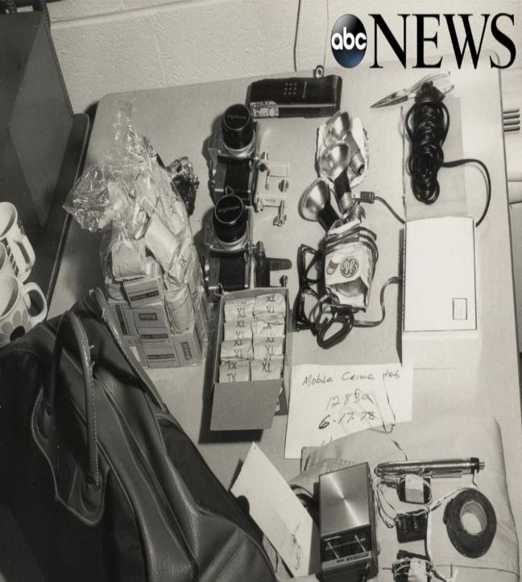

Slide 11
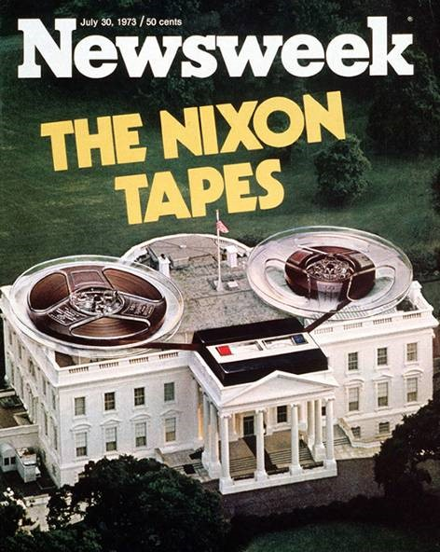

Slide 12
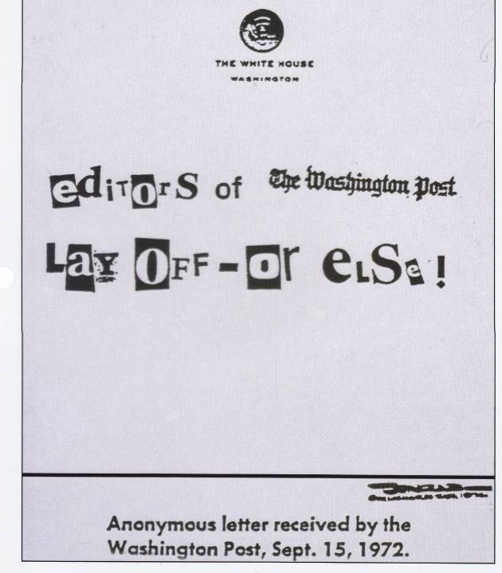

Slide 13
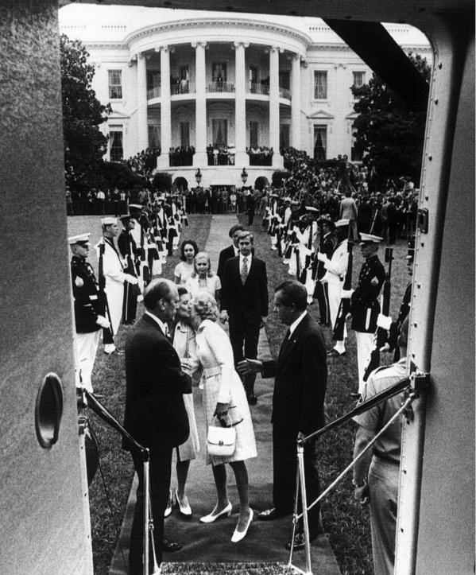

Slide 14
Nixon’s Presidency (SSUSH22b)
The Watergate Scandal
Nixon administration’s attempt to cover up a burglary of the offices of the Democratic Party in the Watergate apartment and office complex in Washington, D.C.
Nixon wanted information on Democrats to help him win his reelection.
Nixon won reelection in 1972, but his efforts to cover up the crime soon unraveled and, facing impeachment, he resigned in 1974.
The result of scandal was a decrease in Americans trust in the federal government (voting decreases) and government creates new laws on campaign financing.

Slide 15
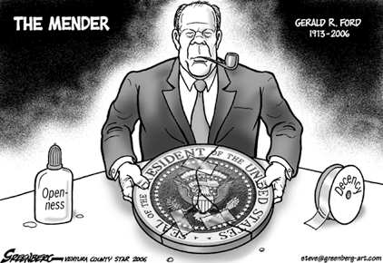

Slide 16
Ford’s Presidency (SSUSH22b)
Gerald Ford Pardons Nixon
Ford Pardon’s Nixon so that he does not have to go to jail
Ford wants to bring the country back together, but the pardon only make citizens lose trust in the government and rule of law.

Slide 17
Who are these guys?
Anwar Sadat (Egypt)
Jimmy Carter (U.S.)
Menachem Begin (Israel)

Slide 18
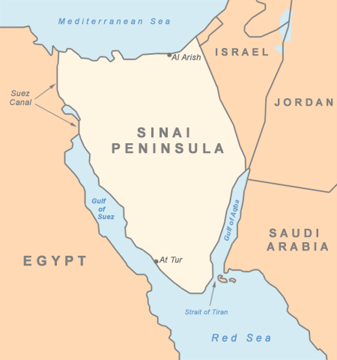
Carter’s Presidency (SSUSH22a)
The Camp David Accords
Carter negotiated a peace agreement between the Egyptian president and the Israeli prime mister
First peace agreement between Middle Eastern nations.

Slide 19
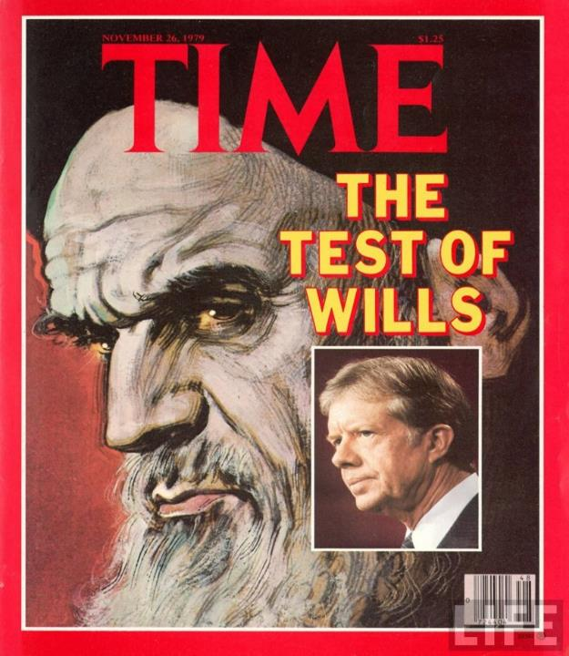

Slide 20
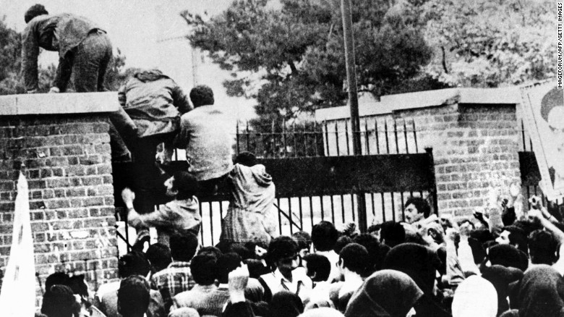

Slide 21
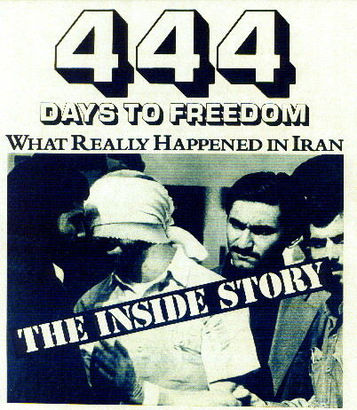

Slide 22
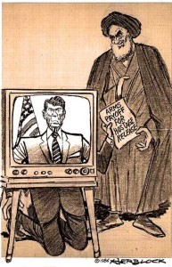

Slide 23
Carter’s Presidency (SSUSH22a)
The Iran Hostage Crisis
Began with the Iranian Revolution
The shah (king) of Iran (friendly to Americans) was removed by the new Ayatollah (Muslim Religious Leader) of Iran.
Later, the shah seeks medical help from Carter in America
Angry Iranians invaded the U.S. embassy in Iran and took 52 Americans captive.
The Iranian hostage crisis lasted 444 days, until the captives were released after the election of Ronald Reagan as president, and it nurtured anti- Americanism among Muslims around the world.

Slide 24
Review Questions
What was the significance of Nixon’s trip to China?
What was the significance of the War Powers Act?
What was the significance of Carter’s Camp David Accords?
What was the significance of the 1979 Iranian Revolution?
What was the significance of the Iranian Hostage Crisis?

Slide 25
Document Analysis
As the tide of chemicals born of the Industrial Age has arisen to engulf our environment, a drastic change has come about in the nature of the most serious public health problems…. Today we are concerned about a different kind of hazard that lurks in our environment – a hazard we ourselves have introduced into our world as our modern way of life has evolved.
The new environmental health problems are multiple – created by radiation in all its forms, born of the never ending stream of chemicals now pervading the world in which we live… no less frightening because it is simply impossible to predict the effects of lifetime exposure to chemical and physical agents that are not part of the biological experience of man.
Source: Rachel Carson, Silent Spring (New York: Houghton Mifflin and Co, 1962): 187-18

Slide 26
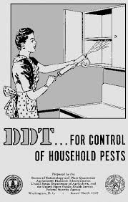

Slide 27
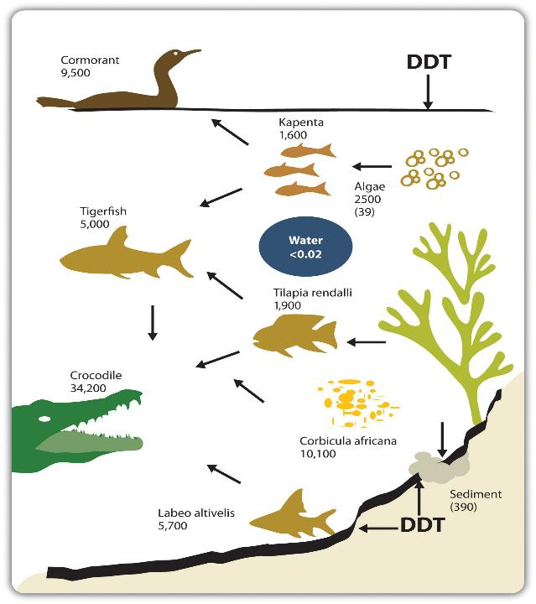

Slide 29
Major Domestic Issues (SSUSH22b)
Creation of the Environmental Protection Agency
In 1962, Rachel Carson’s book Silent Spring, exposed Americans to the dangers of pesticides on the environment.
As a result of Silent Spring, Nixon creates the Environmental Protection Agency
Creation of the Environmental Protection Agency (EPA) to set limits on pollution, to conduct environmental research, and to assist state and local governments in the cleanup of polluted sites.

Slide 31
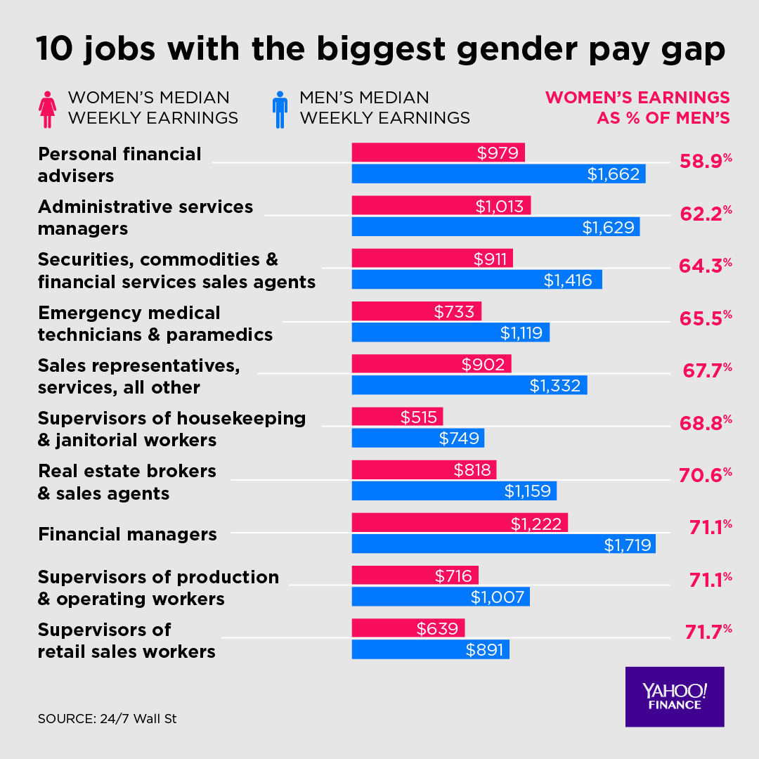

Slide 32
Major Domestic Issues (SSUSH22b)
Emergence of the National Organization for Women
The National Organization for Women (NOW) was founded by Betty Friedan and others in 1966 to promote equal rights and opportunities for America’s women.
NOW’s goals included equality in employment, political and social equality, and the passage of the equal rights amendment.

Slide 33
Review Questions
What was the significance of the Environmental Protection Agency?
What was the significance of the National Organization for Women?
What was the Watergate Scandal?
List two results of the Watergate Scandal
Which president pardoned Nixon?

Slide 34
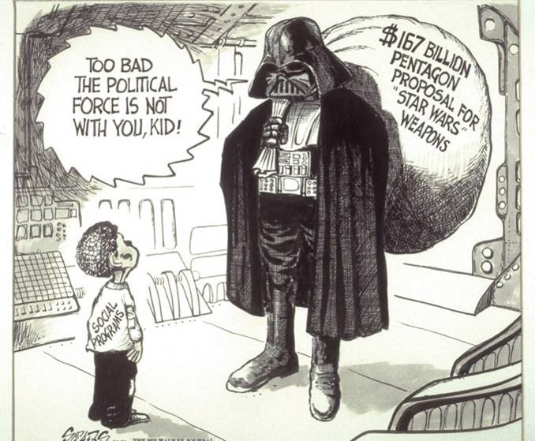

Slide 36
Reagan’s Presidency (SSUSH23a)
Reaganomics
An economic policy that included budget cuts, tax cuts and increased defense spending.
Tax cuts helped business and U.S. get out of an economic recession.
By cutting social welfare budgets, Reagan’s policy hurt lower-income Americans and led to a severe recession.

Slide 37
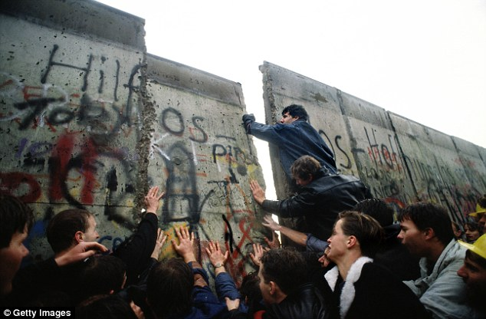

Slide 38
Reagan’s Presidency (SSUSH23a)
Collapse of the Soviet Union
A foreign policy where Reagan talked the Soviet Union leader (Mikhail Gorbachev) into allowing free speech, freedom of assembly in the U.S.S.R., and economic rebuilding (Glasnost and Perestroika)
These policies put the U.S.S.R on the path to a democratic form of government.
In a 1987 speech, Reagan challenged Gorbachev to “tear down this wall!” as a symbol of increasing freedom in the U.S.S.R.
The Wall fell on Nov. 9th 1989 (symbolic end of Soviet Union)

Slide 39
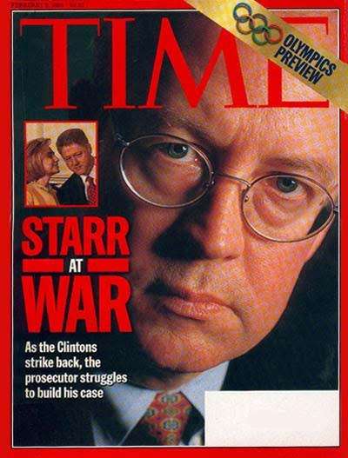

Slide 40
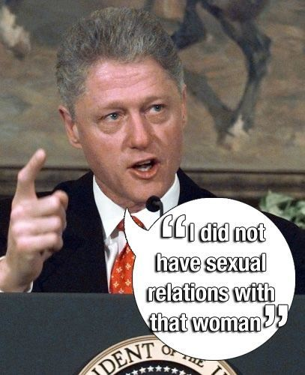

Slide 41
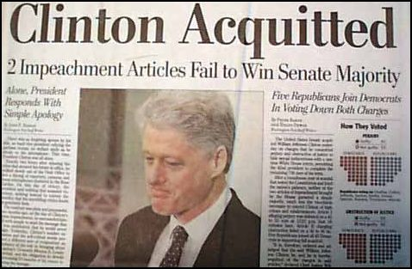

Slide 42
Clinton’s Presidency (SSUSH23a)
Bill Clinton’s Impeachment
Clinton became the second president in U.S. history to suffer impeachment.
The House of Representatives charged him with perjury and obstruction of justice.
The charges were based on accusations of improper use of money from a real estate deal and allegations he had lied under oath about an improper relationship with a White House intern.
Clinton denied the charges and the Senate acquitted him, allowing Clinton to remain in office and finish his second term.

Slide 43
Review Questions
What happened to the Soviet Union during the Reagan Administration?
What was the significance of Reaganomics?
Why was Bill Clinton impeached?
What was the result of Bill Clinton’s impeachment?

Slide 45
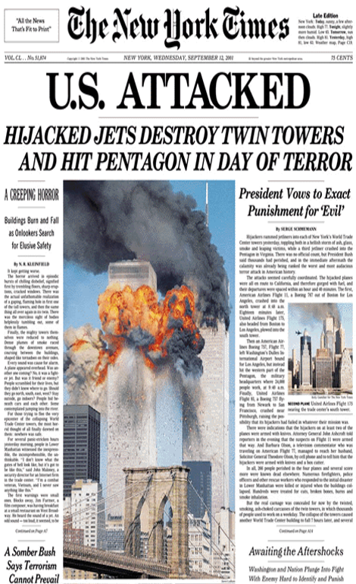

Slide 46
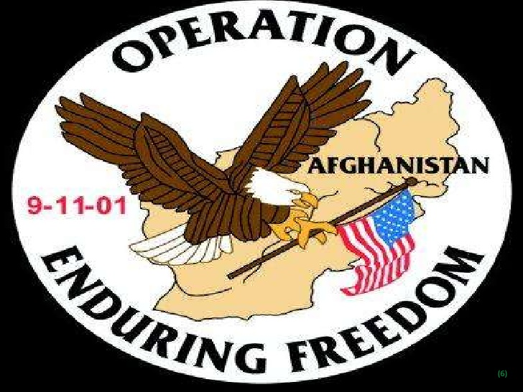

Slide 47
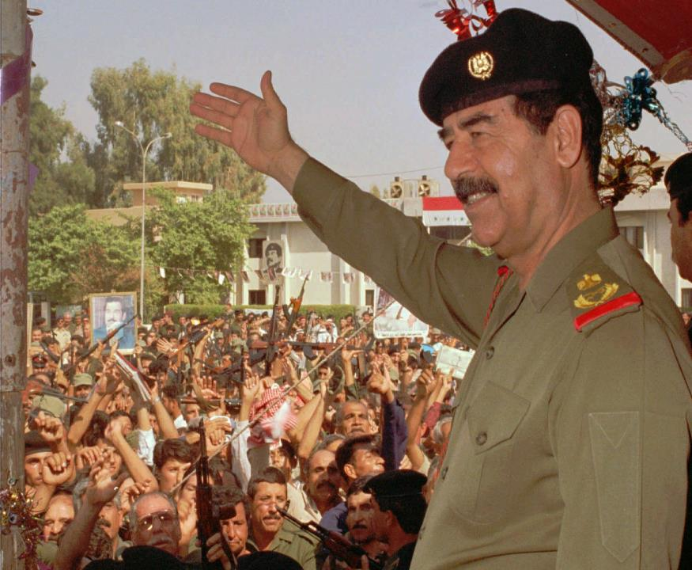

Slide 48
G. W. Bush’s Presidency (SSUSH23a)
Attacks on 9/11
September 11, 2001, (9/11) al-Qaeda’s attack on the Twin Towers and the Pentagon
American Response to 9/11 attack:
Created the Patriot Act, which increased the ability of American law enforcement agencies can search private communications and personal records
Created the Department of Homeland Security (responds to terrorist attacks and natural disasters)

Slide 49
G. W. Bush’s Presidency (SSUSH23a)
War on Terrorism
Operation Enduring Freedom (2001), U.S. invasion of Afghanistan with allied forces. (for harboring al-Qaeda leader Osama bin Laden and start of War on Terrorism)
Operation Iraqi Freedom (2003), U.S. invasion of Iraq to search for Weapons of Mass Destruction (WMD) and as part of War on Terrorism.
U.S. captures Iraq’s president, Saddam Hussein. U.S. fears Hussein had and could supply terrorist in America. (Executed in 2006 for crimes against humanity)
U.S. captures al-Qaeda leader, Osama bin Laden. U.S fears bin Laden had and could supply terrorist in America. (Killed in 2011, ordered by Barack Obama)

Slide 50
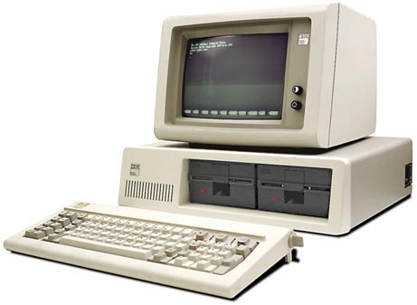

Slide 51
Technological Changes (SSUSH23a)
Technologies changes such as the personal computer and the internet has had a dramatic impact on economic growth of businesses in the United States.
Social Media such as Facebook and Twitter have had major impacts on Presidential Elections.

Slide 52
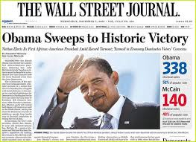
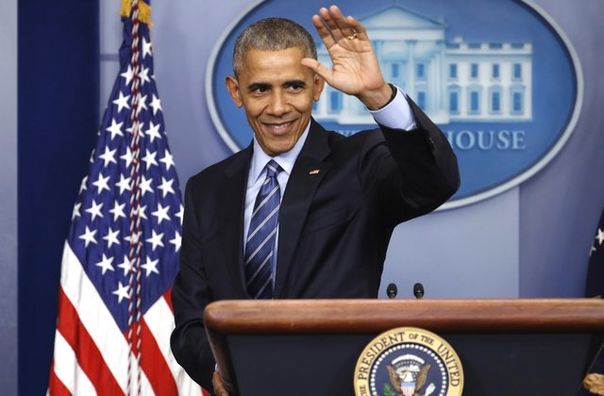

Slide 53
Obama’s Presidency (SSUSH23a)
Election of 2008
Democratic candidate Barack Obama was elected by a wide margin in the election.
This made history as Obama become the first African American to hold the office of presidency of the United States.

Slide 54
Review Questions
Describe the attacks of September 11, 2001?
What was the result of September 11, 2001?
What technologies have impacted American Politics?
What was the significance of the Presidential Election of 2008?

